Slide 1
15 Puzzle Solution Generator
Ziling Zhang & Ruchen (Puck) Wen
Latest

Slide 2
1-Introduction

Slide 3
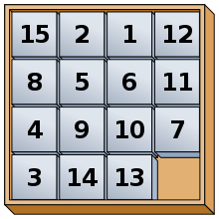
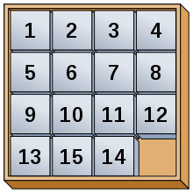
Topic Background
15 Puzzle
The 15-puzzle (also called Gem Puzzle, Boss Puzzle, Game of Fifteen, Mystic Square and many others) is a sliding puzzle that consists of a frame of numbered square tiles in random order with one tile missing.
Wikipedia https://en.wikipedia.org/wiki/15_puzzle
Notes:
Puck

Slide 4
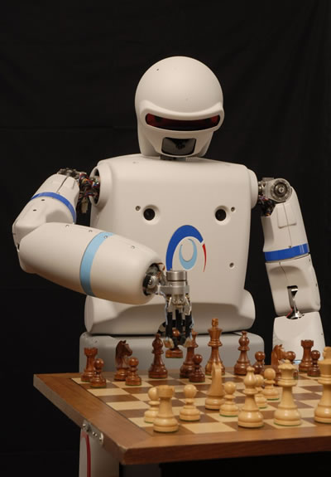
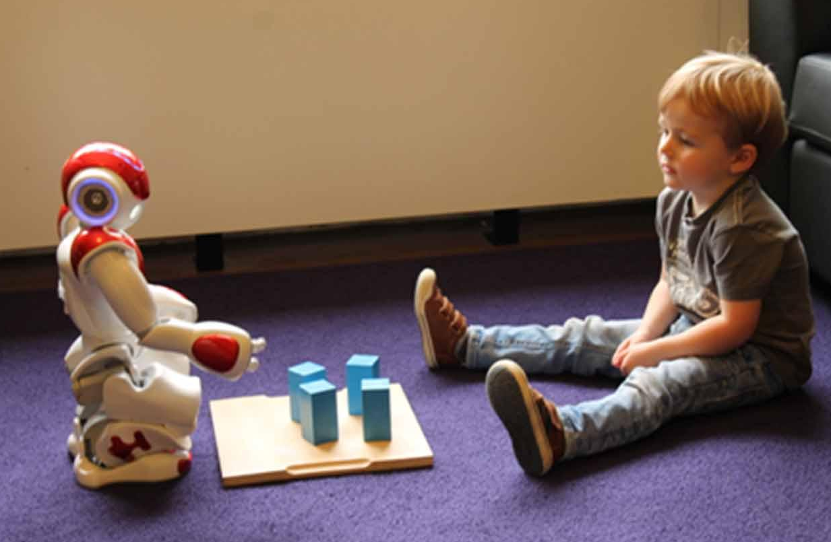
Motivation
Chess/board game playing robots that challenge human
AlphaGo - Go
IBM deep blue - Chess
Rubik’s Cube Solving Robot
Special education
Play games with children with autism
Interactive and educational robots that engage childrens in special education
REEM-A, humanoid robot. Playing chess, https://www.youtube.com/watch?v=2wzT4vafXOA
Vogt P, de Haas M, de Jong C, Baxter P and Krahmer E (2017) Child-Robot Interactions for Second Language Tutoring to Preschool Children. Front. Hum. Neurosci. 11:73. doi: 10.3389/fnhum.2017.00073
Notes:
Puck

Slide 5
Goal
Teach the robot capable of visual perception to play the 15 puzzle.
Notes:
Puck

Slide 6
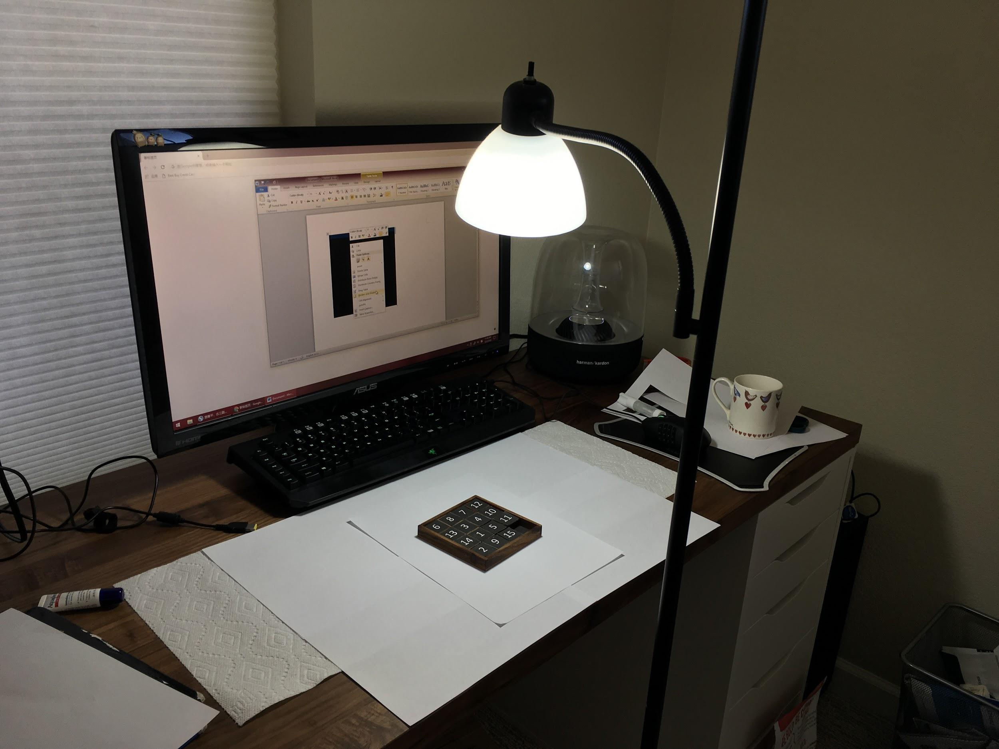
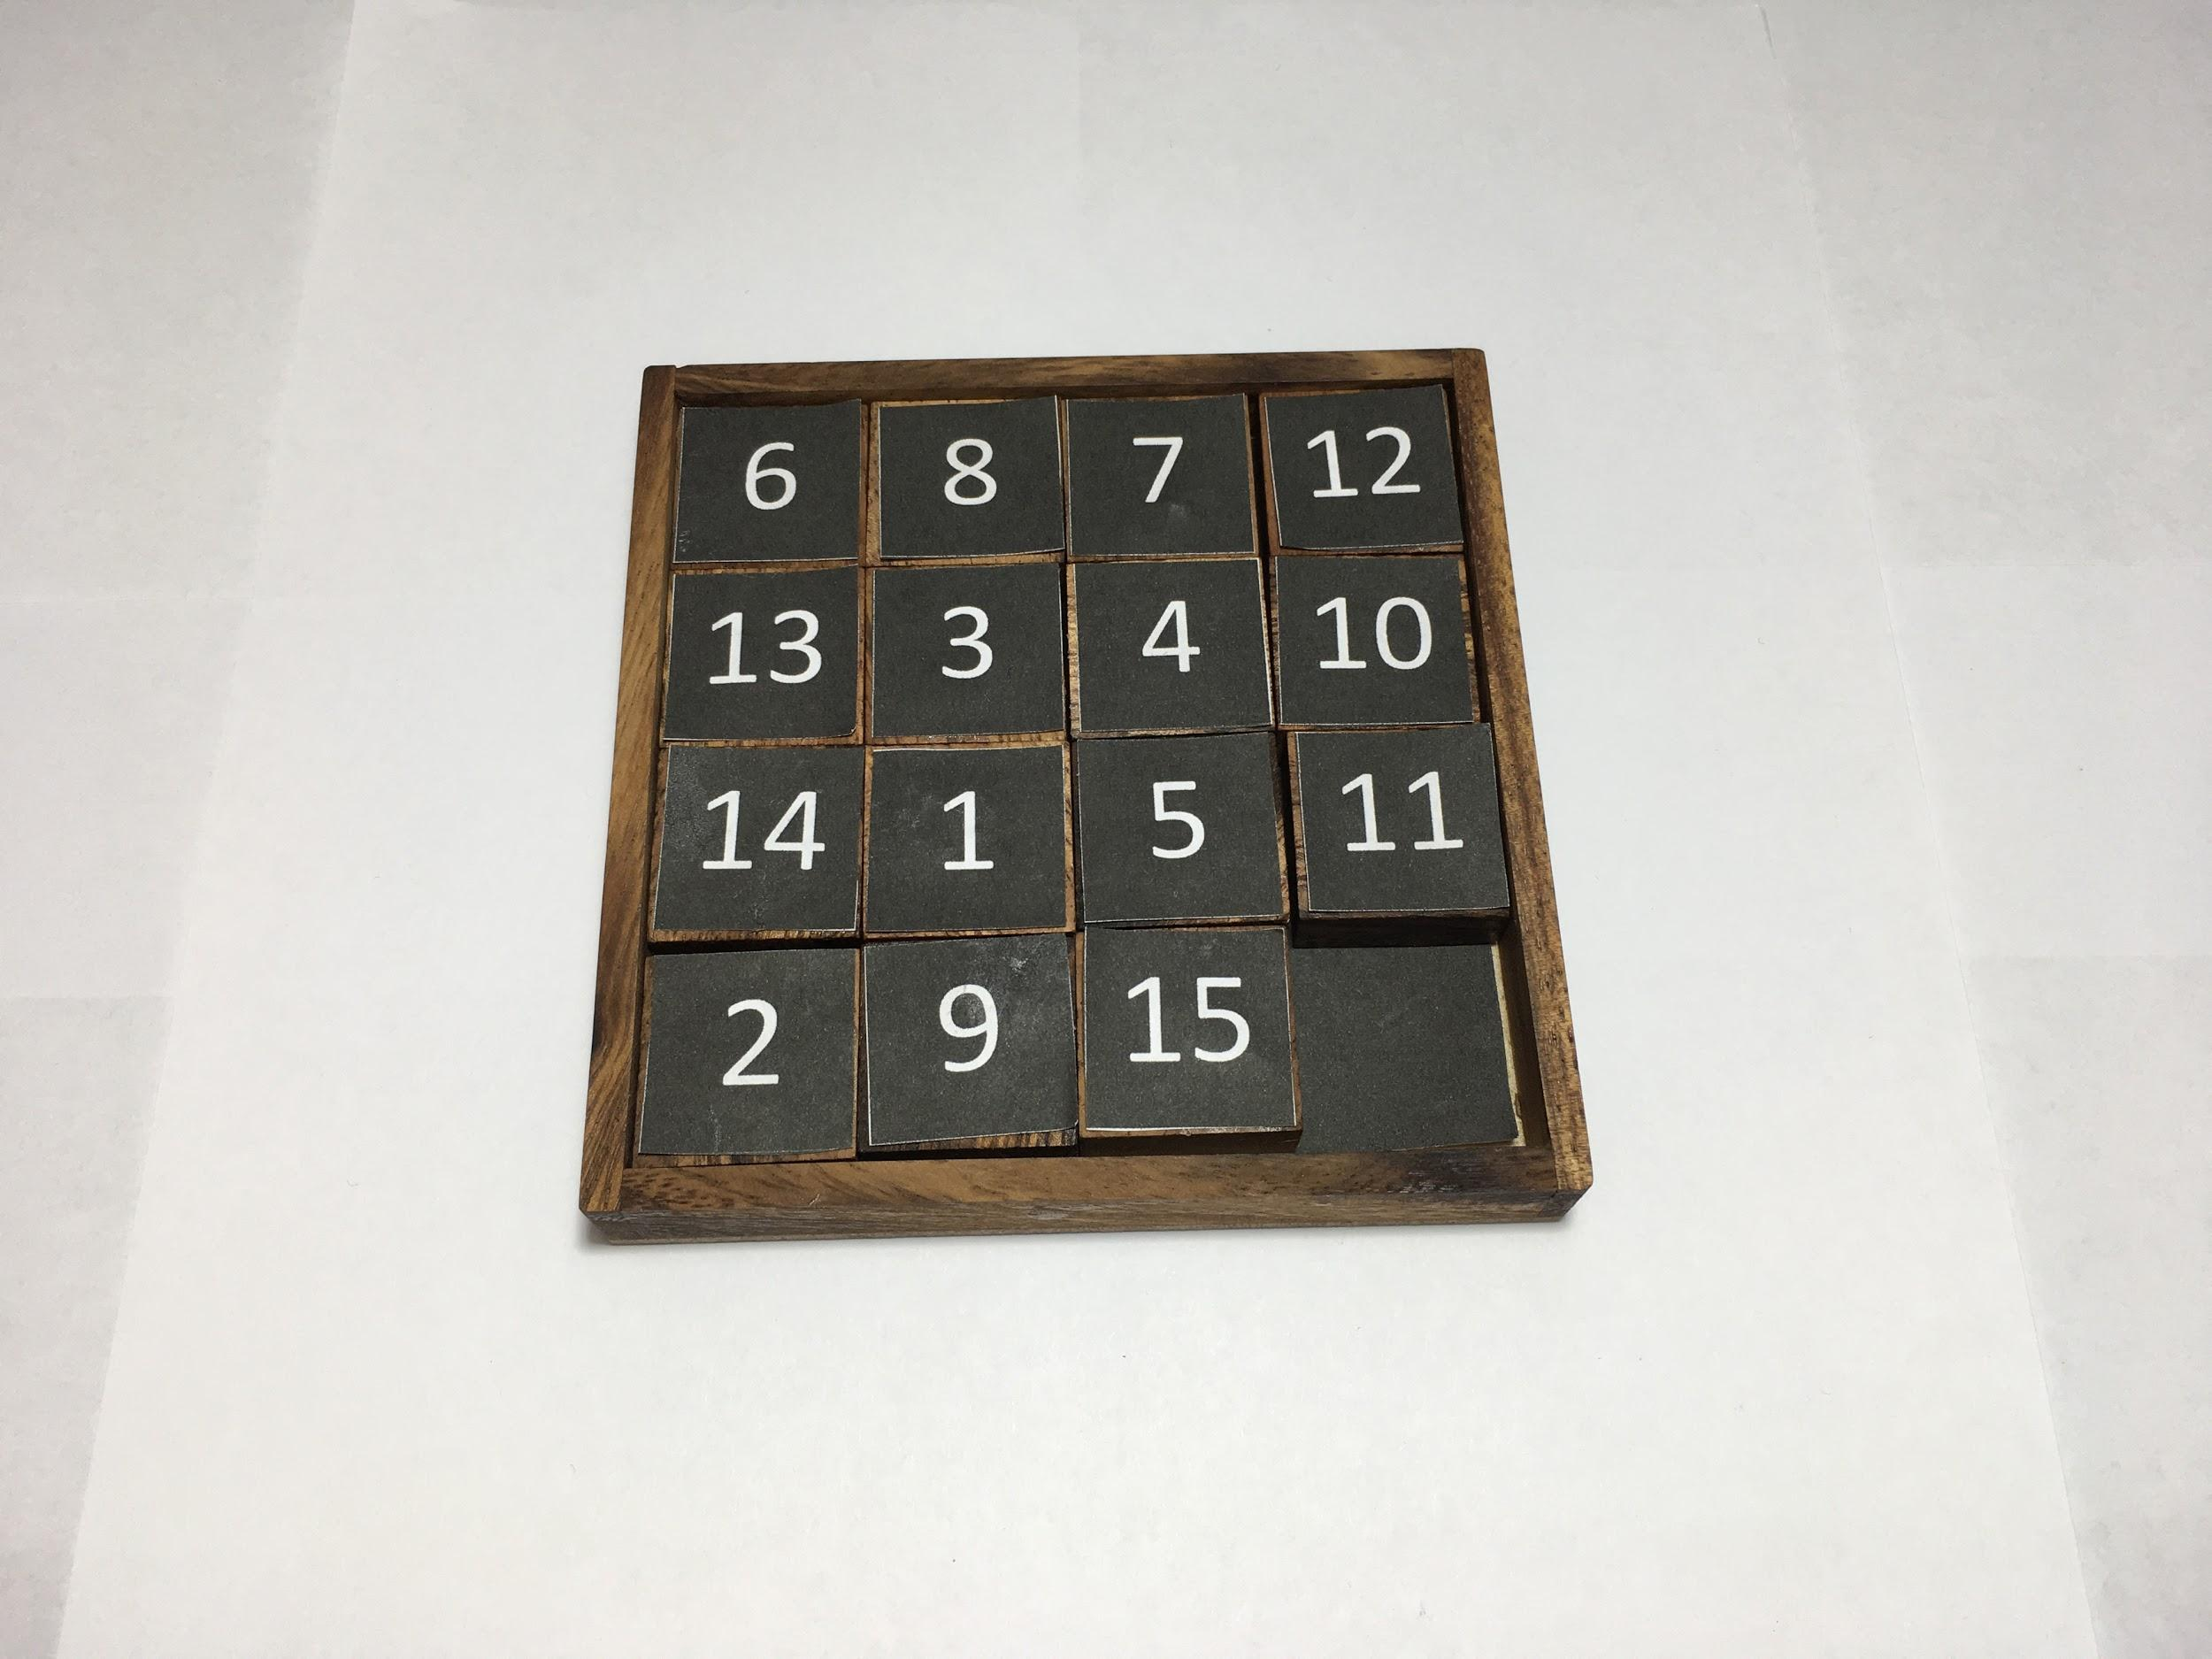
Assumptions
Images Photos of the game board are captured with an iPad
Environment The 15 puzzle 4x4 game board on an office desktop covered with white paper, tiles of the game board were glued with printed white digits on black background
Lighting CFL light source projected from above the game board
Notes:
Puck

Slide 7
2-Methodology

Slide 8
Pipeline / Techniques
Game board detection
Matlab FindSquare() developed in class
Obtain the orthophoto of the board
Slice it into 16 tiles
Game pieces/tiles detection
MatConvNet CNN trained on the MNIST handwritten digit dataset for number detection
Detect numbers in the tiles and return the matrix of current gameboard state
Solution generation
A* algorithms to search through state space, if there is a solution, return the optimal steps
Computer Vision Algorithms
State =
[6,8,7,12;
13,3,4,10;
14,1,5,11;
2,9,15,0]
Graph Search Algorithms
Solution Steps =
[6,8,7,12; [6,8,7,12;
13,3,4,10; -> 13,3,4,10;
14,1,5,11; 14,1,5,0;
2,9,15,0] 2,9,15,11]
[1,2,3,4;
-> ... -> 5,6,7,8;
9,10,11,12;
13,14,15,0]
Notes:
Ziling

Slide 9
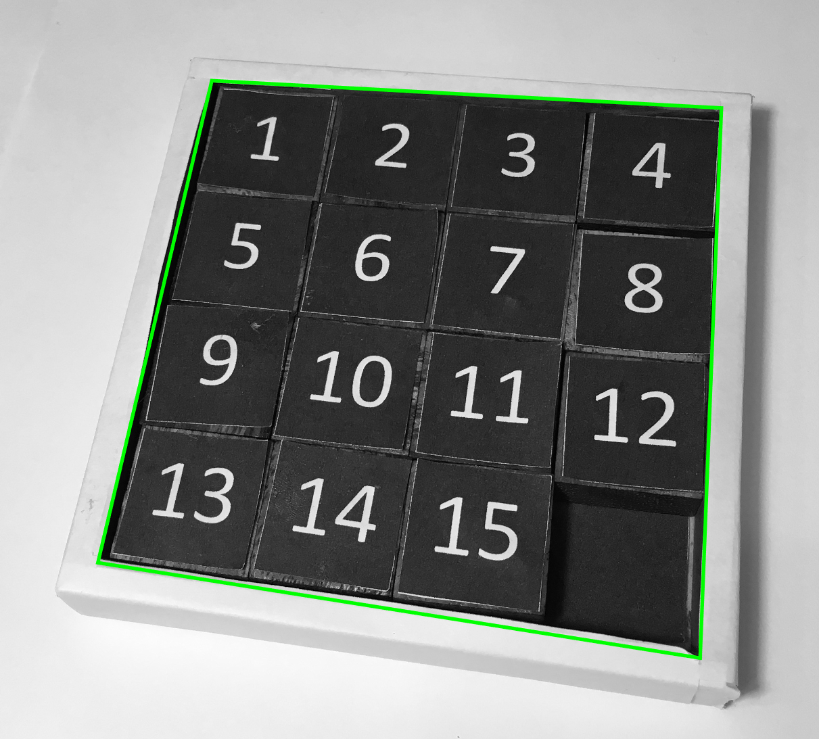
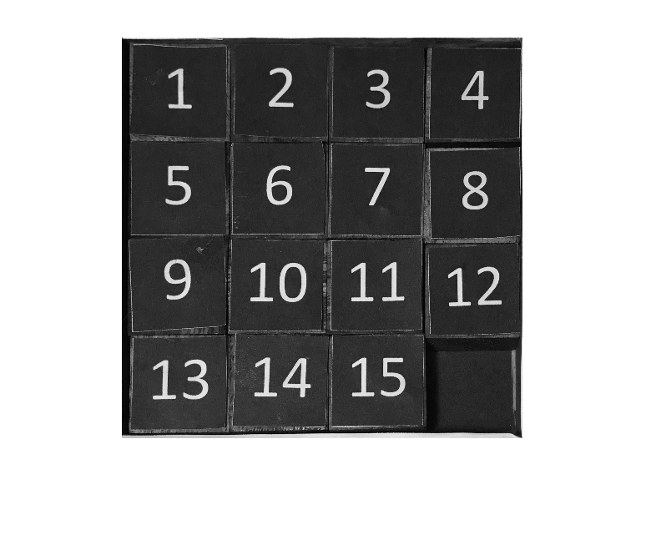
Game Board & Piece Detection
Square Detection Used the FindSquare() matlab function to detect the game board
Transform the board to a 960x960 ortho photo
Image Segmentation Slice the ortho photo into 16 240x240 tiles
Notes:
ZIling

Slide 10
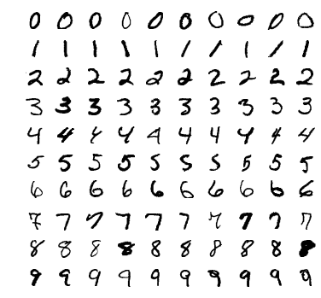
Number Recognition
Convolution Neural Network
The MNIST dataset of handwritten digits 28x28 pixels, 60000 images
Notes:
Ziling

Slide 11
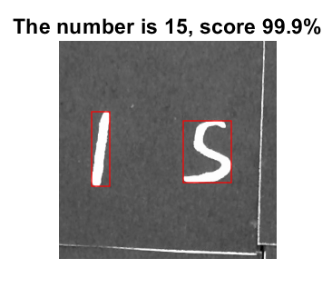
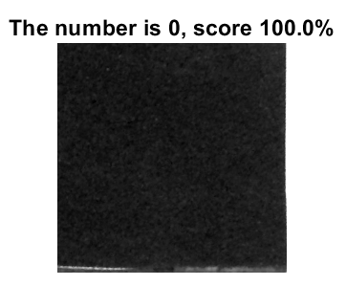
Modifying the pipeline to detect double digits / Empty Tile
Problems:
The CNN trained on MNIST achieved 99% accuracy in detecting handwritten digits 0~9, but our game pieces contain double digits and an empty tile
MNIST digits were centered in a 28x28 image by computing the center of mass of it’s pixels
Due to orthophoto error, our cropped tiles aren’t centered as accurately as training data
Our Solution: bwlabel()

Slide 12
Modifying the pipeline to detect double digits / Empty Tile
Find connected white blobs region proposals
2 Digits: If the tile contains 2 medium size blobs(area > 500), it should be 2 digit. If there’s only one large blob(area>3000), it should be 1 digit. Then we crop the image with a 120x120 box anchored at the centroids of these two blobs, and send the two cropped images to CNN for number detection.
Empty Tile: If there’s no decent size blobs, mark the image as empty tile, “0”
Notes:
Ziling

Slide 13
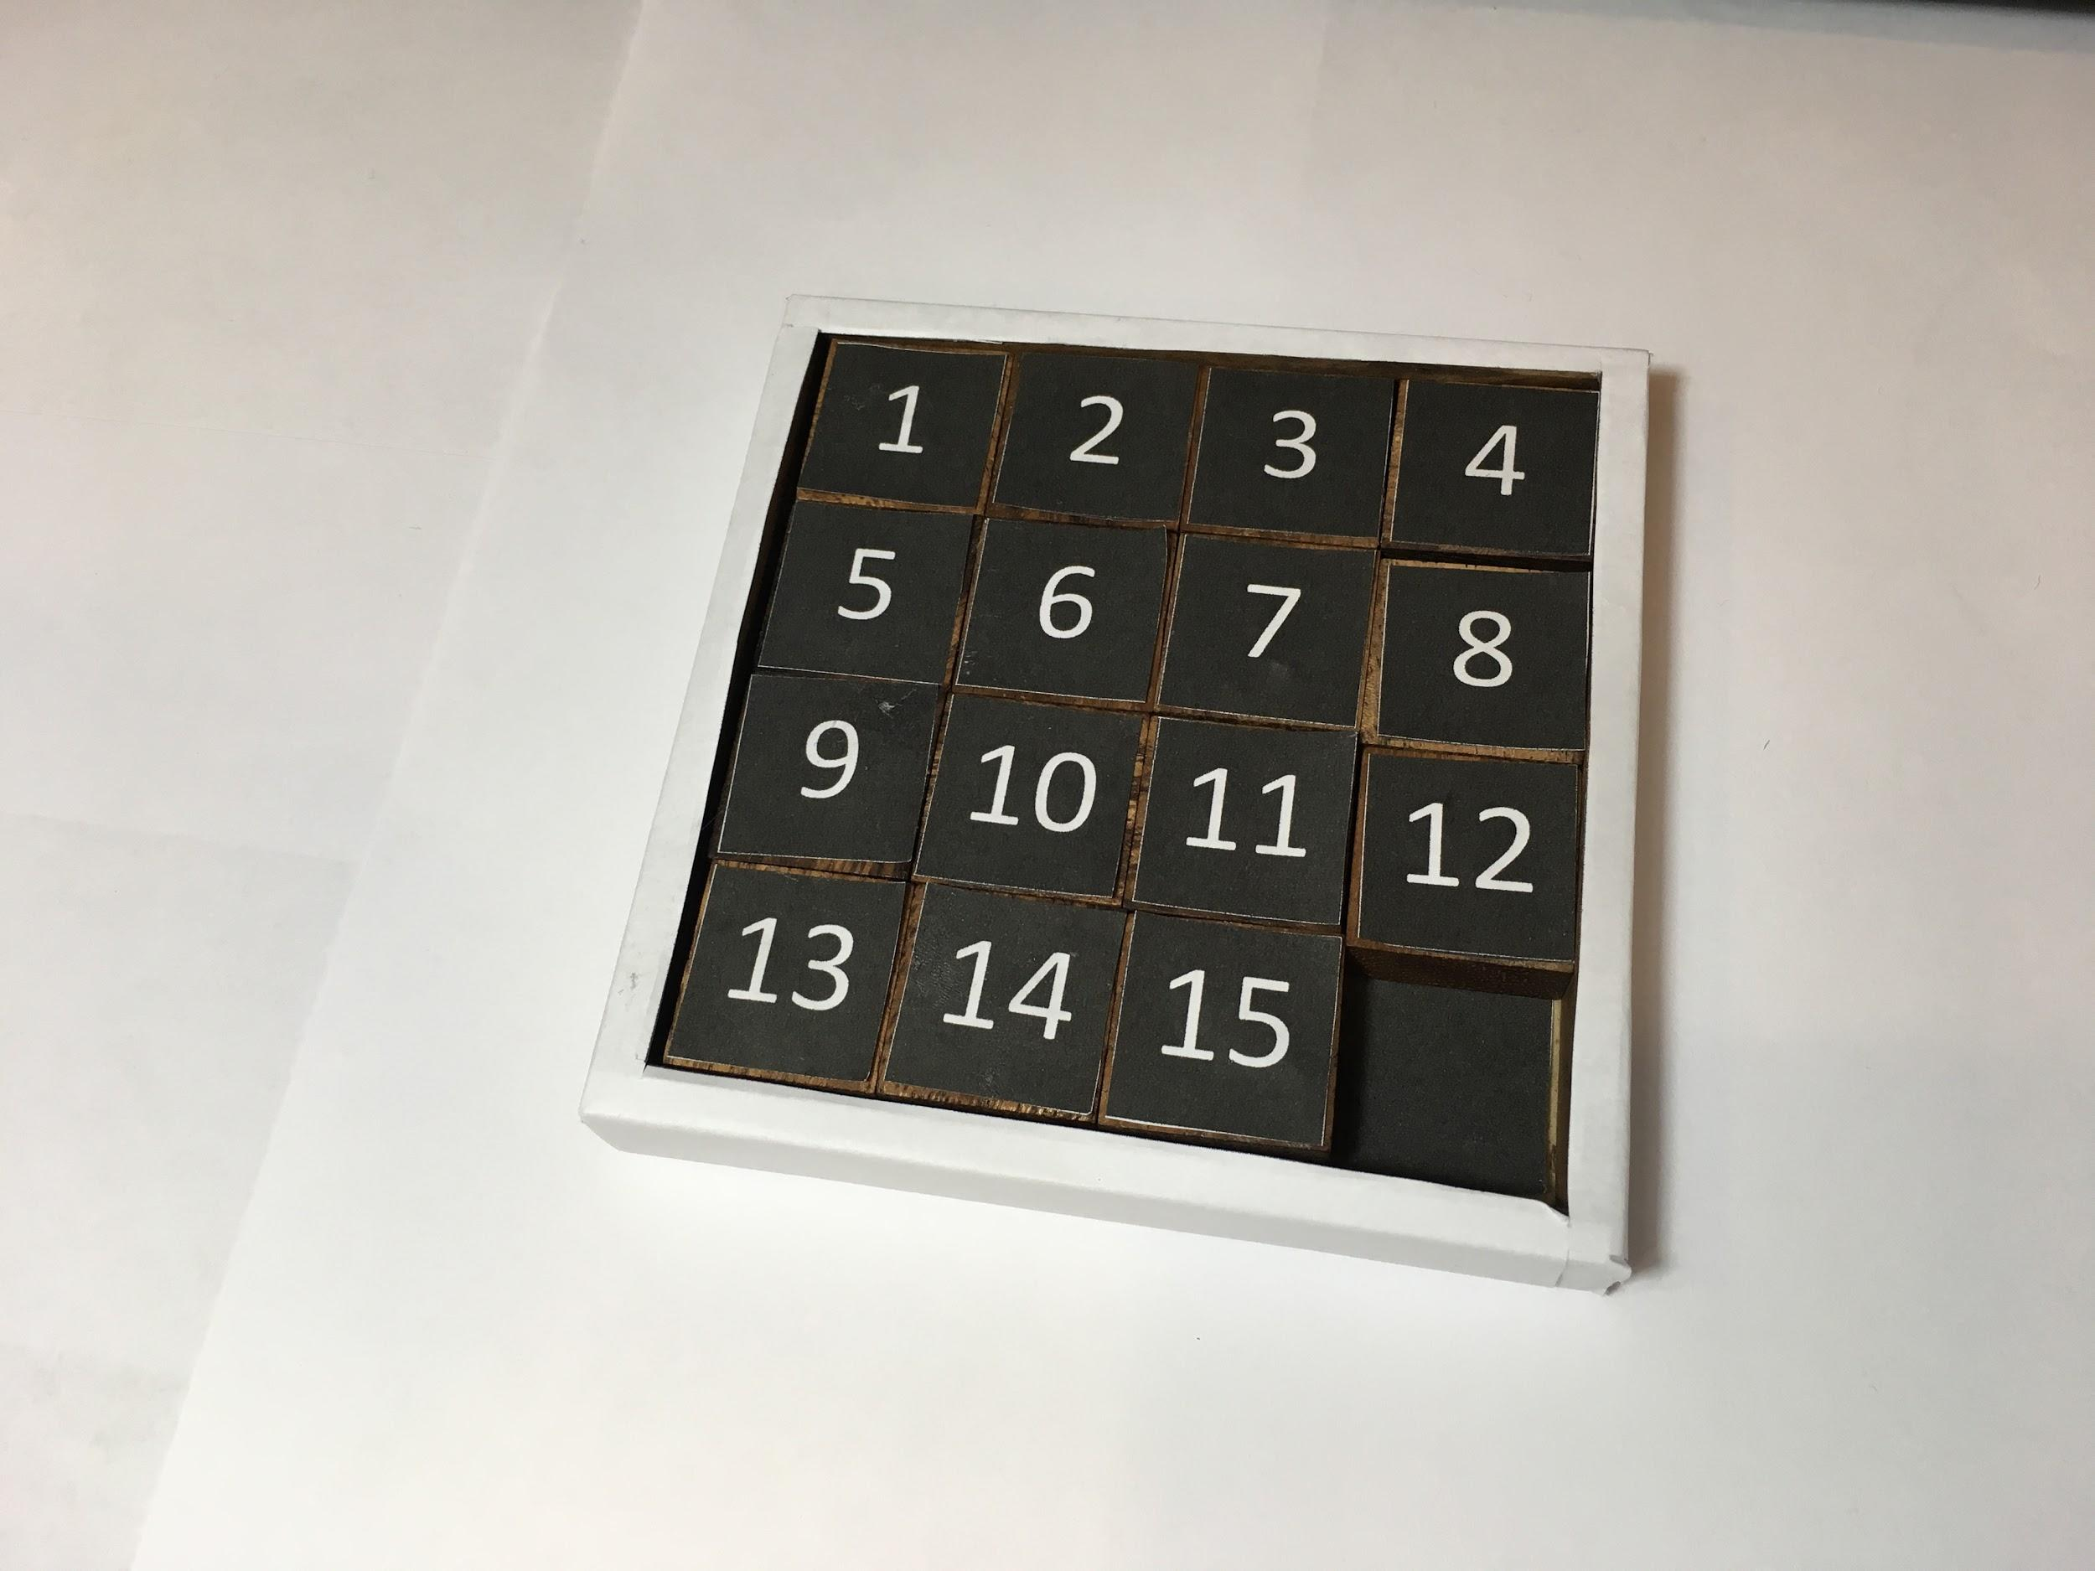
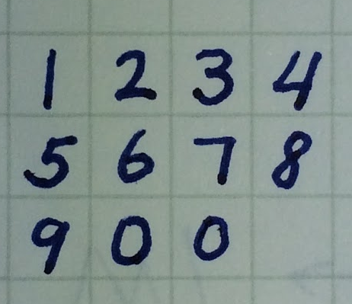
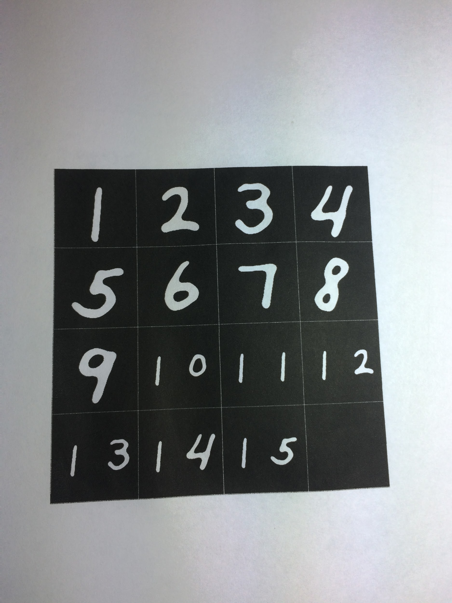
Generalization of the CNN
MNIST is a handwritten digits dataset, the network didn’t generalize well on computer fonts
1 frequently registered as 7
So we used a printer to print a handwritten board, but still …
5 was recognized as 3
0 was recognized as 9
2 registered with score 67.7%
Board 1.0, accuracy < 0.60
Notes:
Ziling

Slide 14
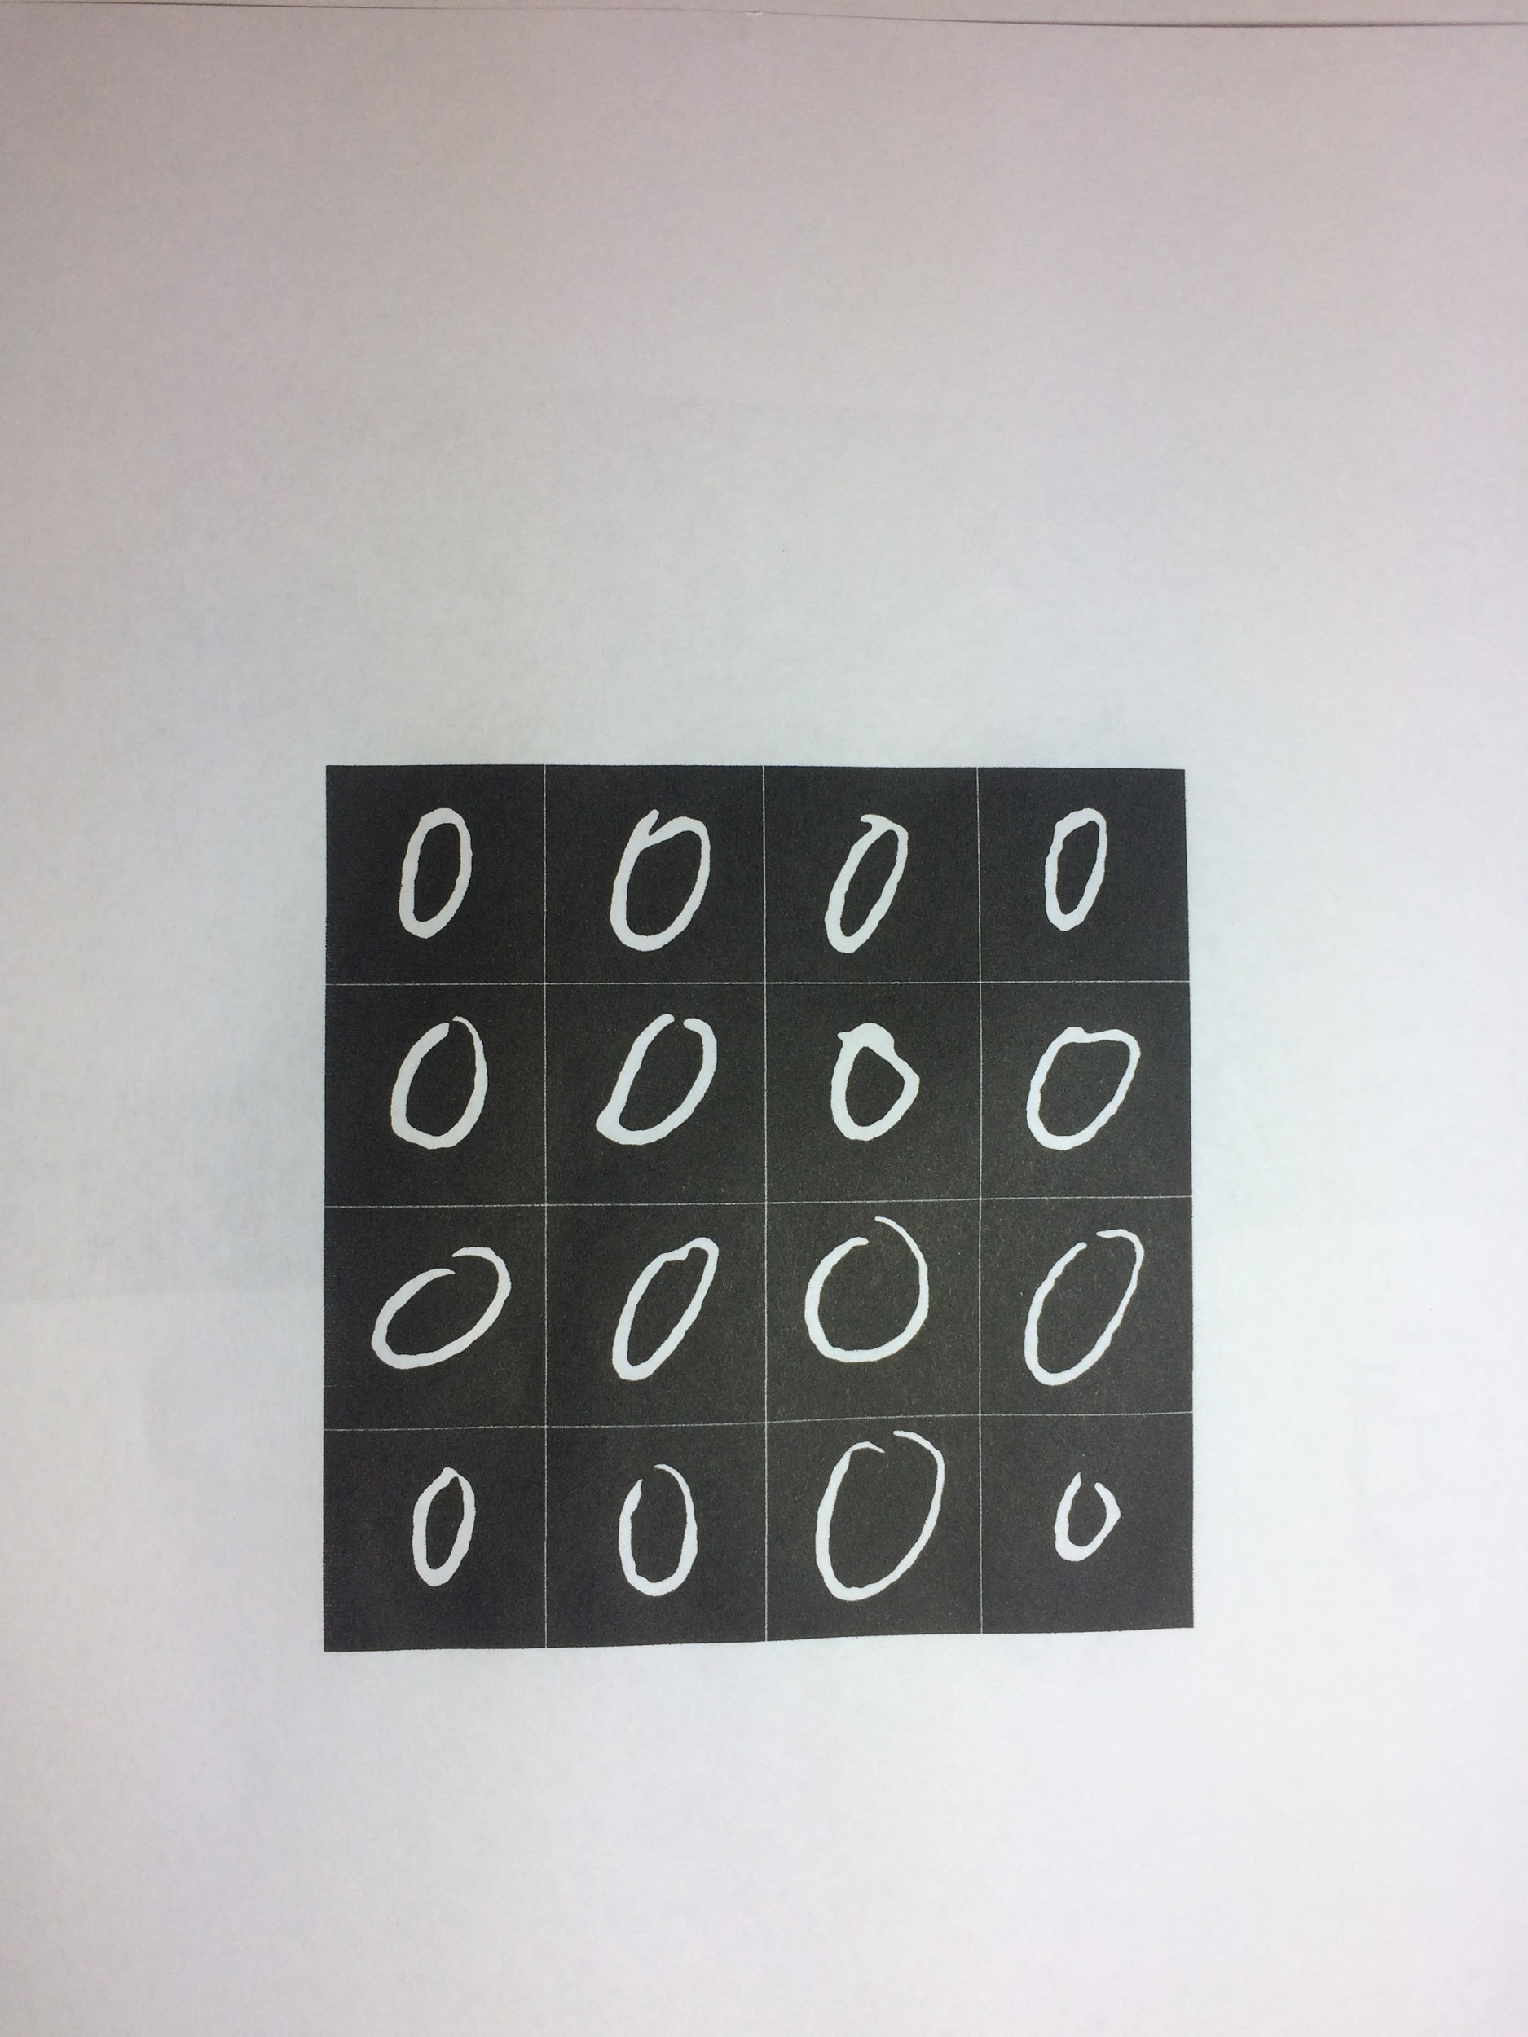
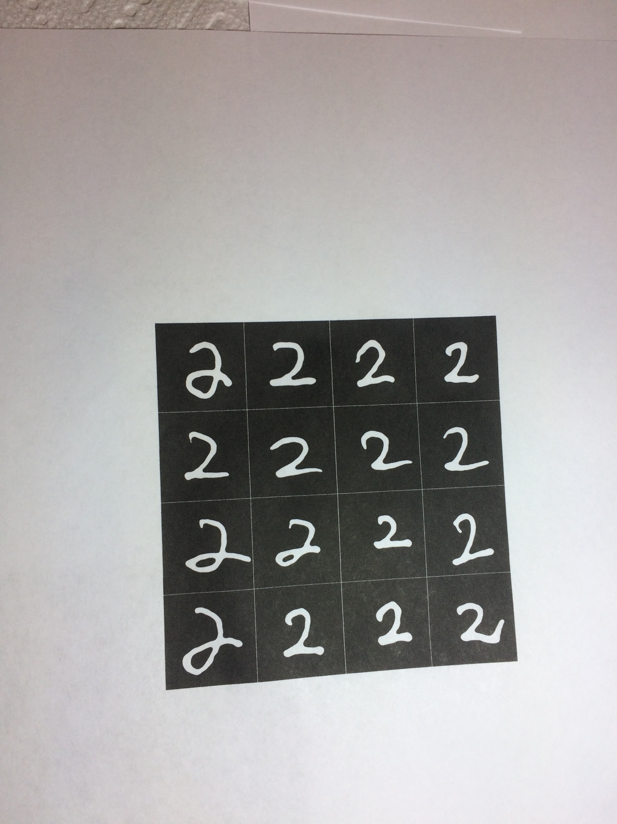
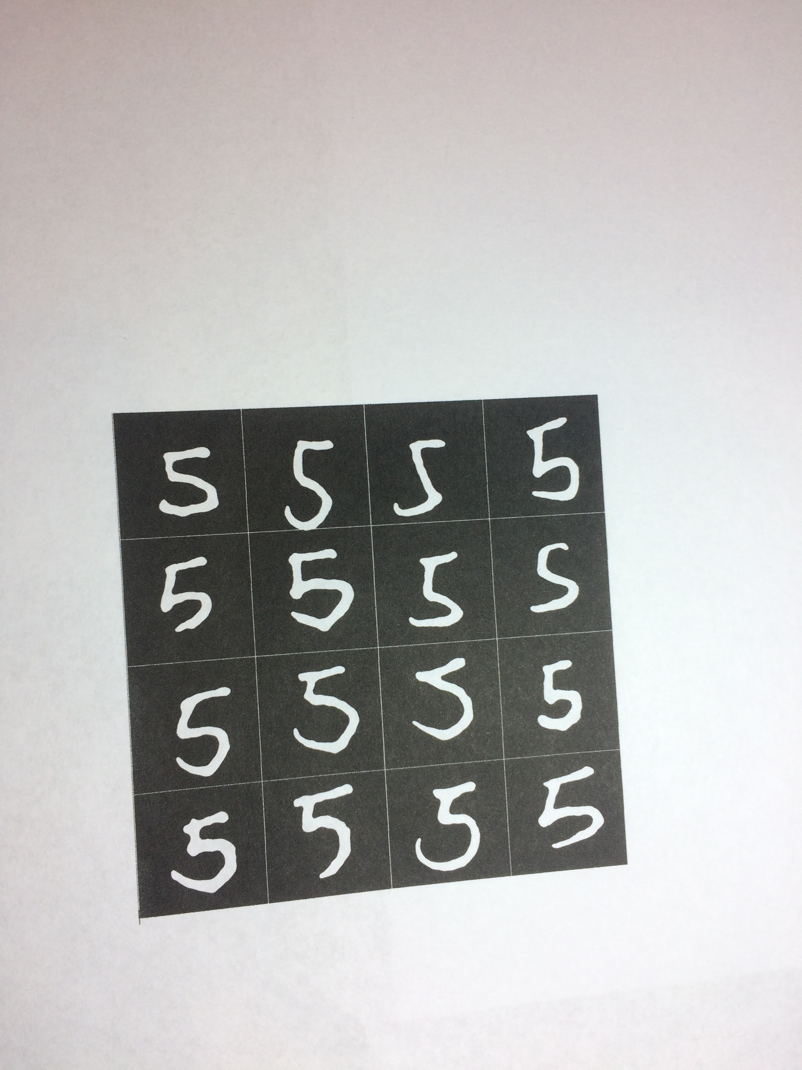
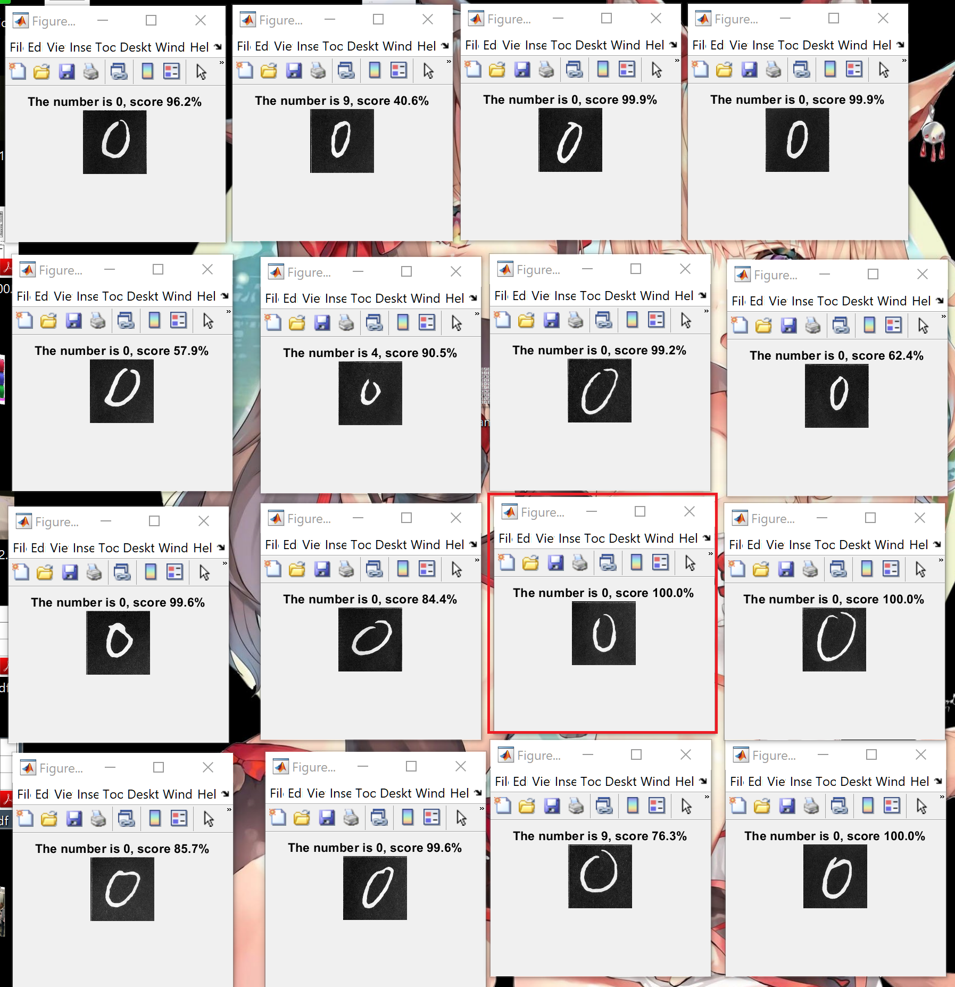
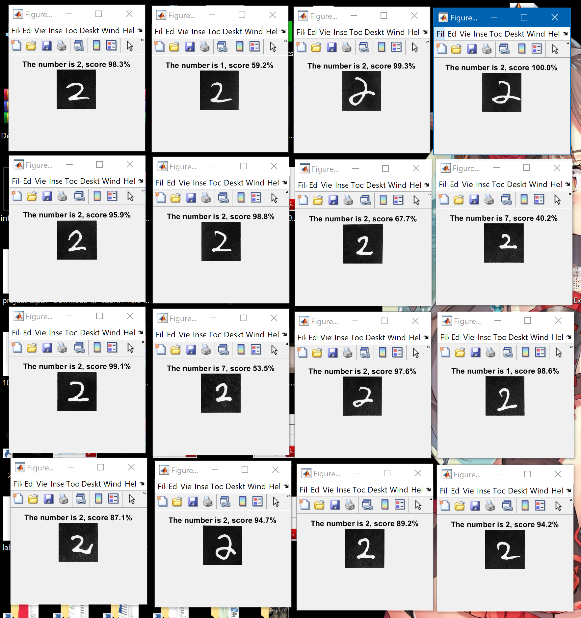
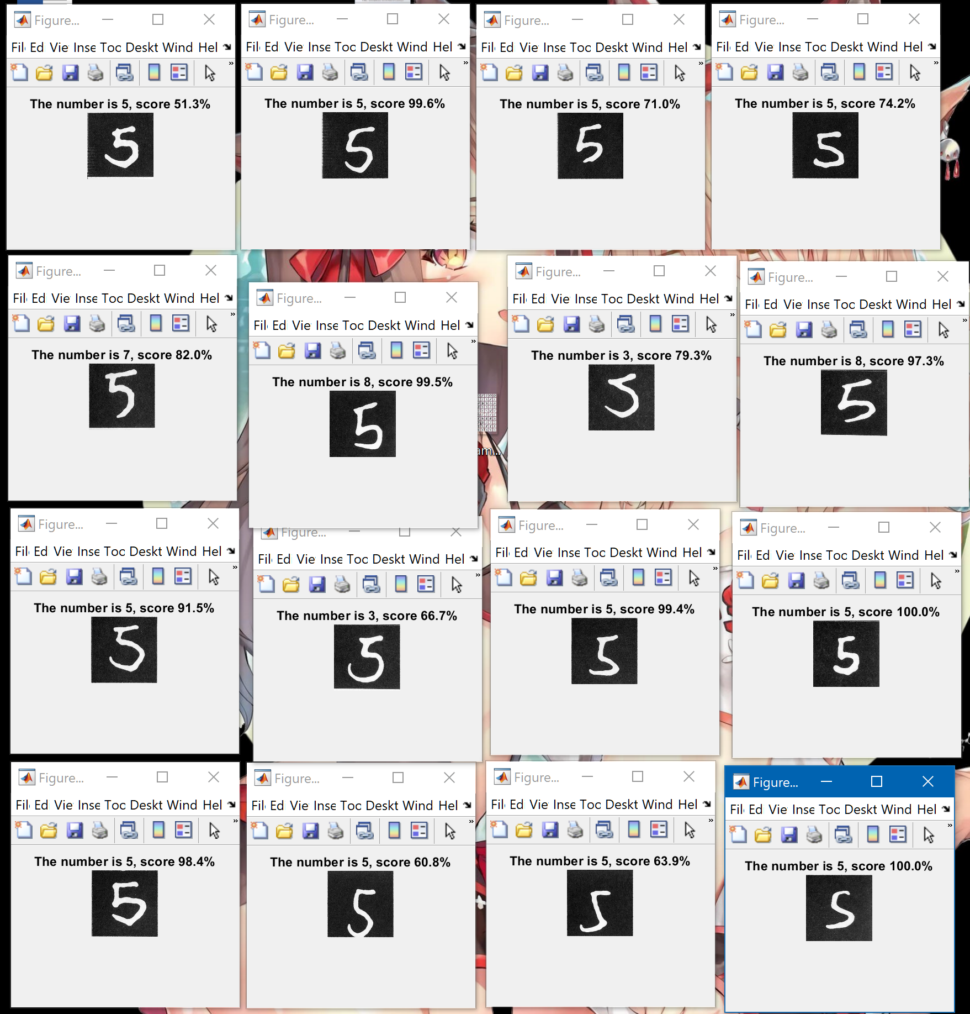
The most visually salient
handwriting style
Then we utilize our pipeline to test out 4x4 different handwritings of 0, 2, 5
highest CNN score -> most salient writing style
Notes:
Ziling

Slide 15
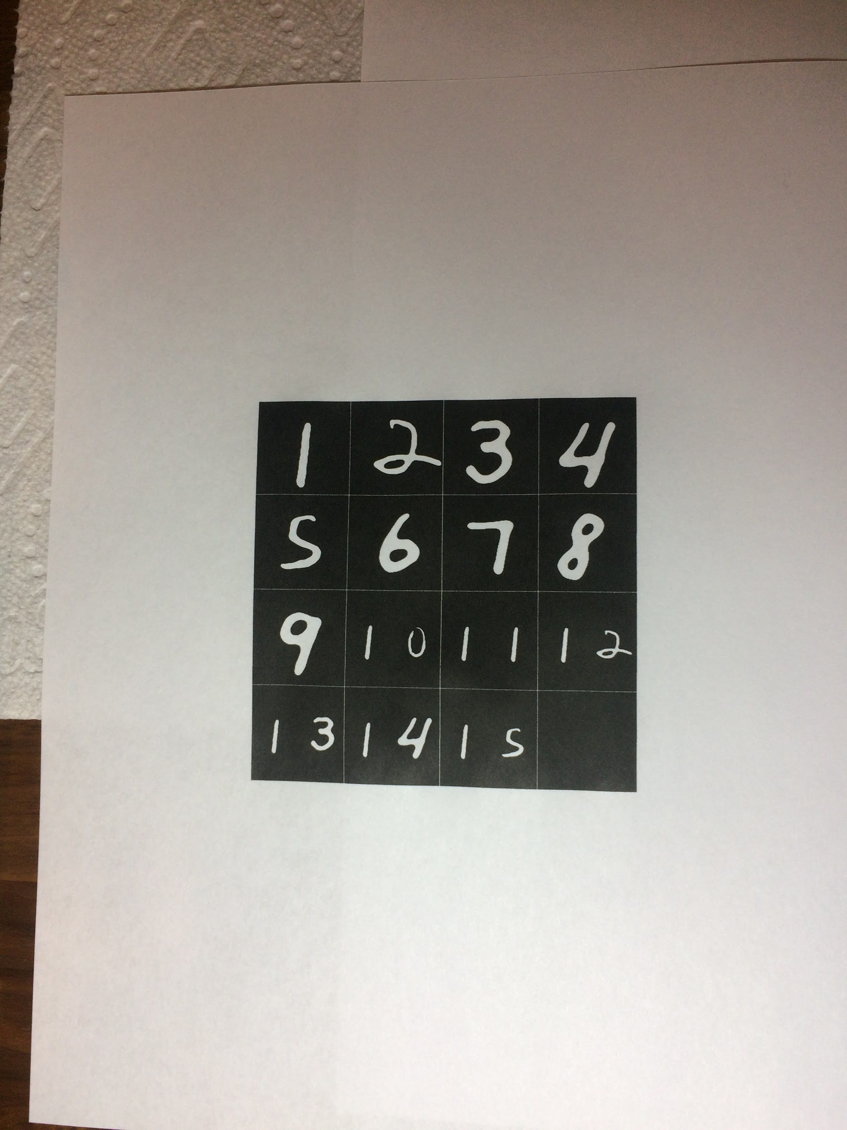
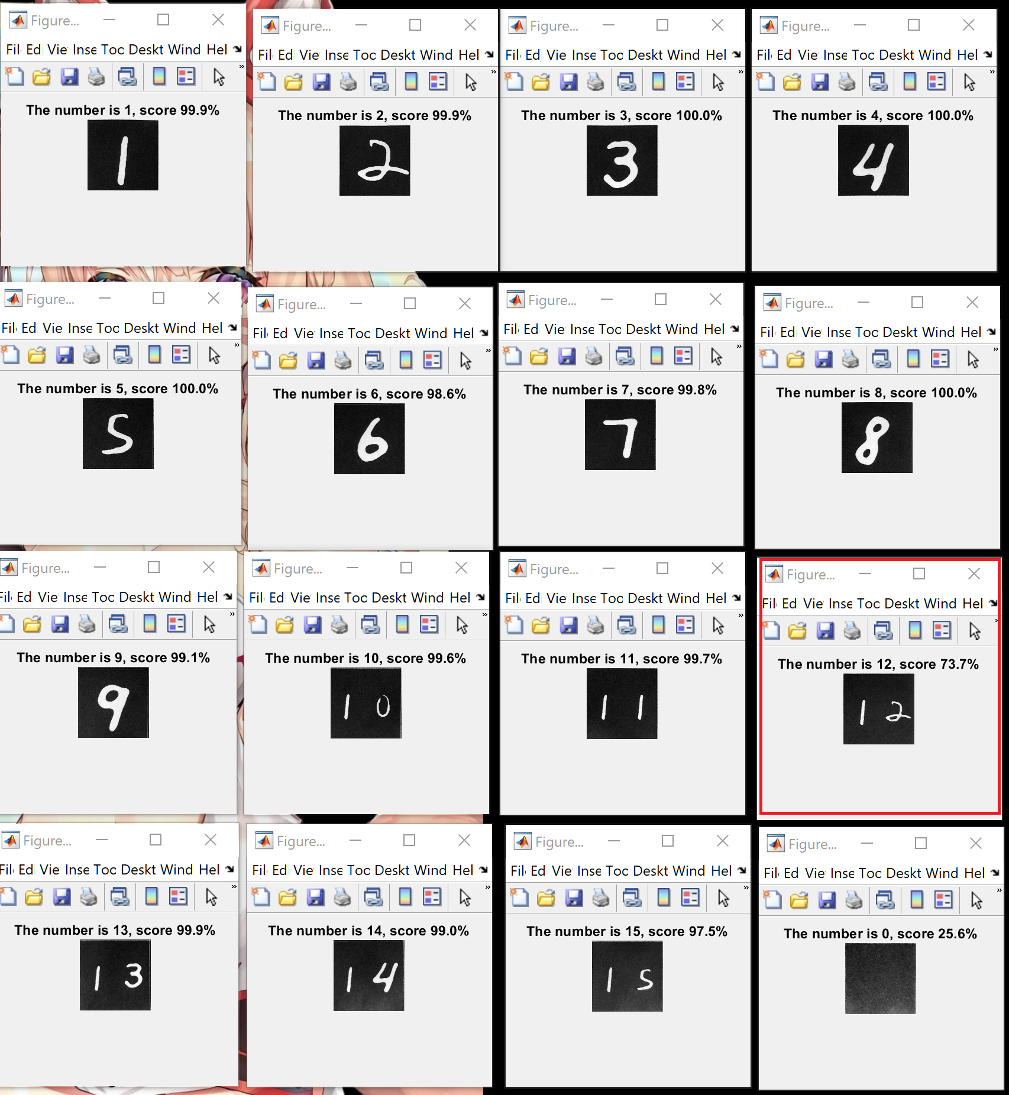
All Pieces are detected!
The Final Board, with all pieces detected!
Notes:
Ziling

Slide 16
Game Board Orientation
The FindSquare() Function could return a board with 4 possible orientations
But in the wrong orientation, the total detection score of 16 tiles is very low, also, if the detected higher digit isn’t 1, we set the detected score to 0 Out of a full score of 16 obtainable:
Right Side Up: 14.9218
+90° : 5.7415
+180° : 3.993
+270° : 9.331
The Right Side Up is quite differentiable from other orientations
Notes:
Ziling

Slide 17
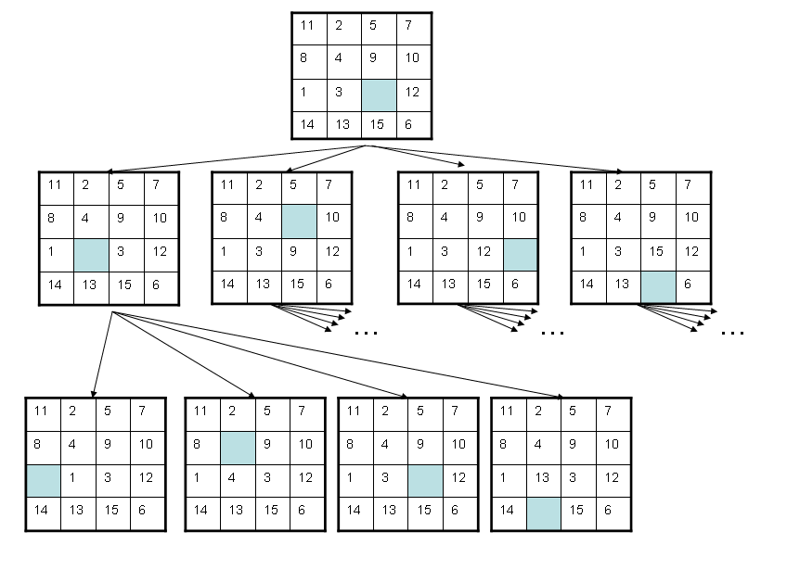
Solution Generation
A* search algorithm

Slide 18
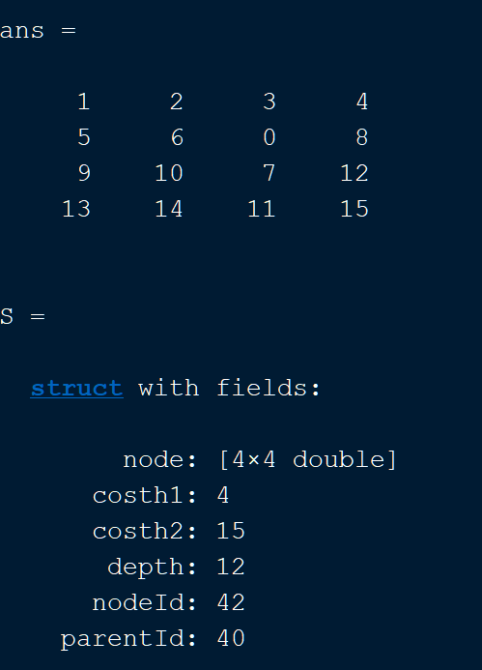
Solution Generation
A* search algorithm
How we pick the best node?
Cost1: How many tiles are in the wrong positions
Cost2: Heuristic + Depth + 1
Heuristic: How many moves for each tile to reach the right position

Slide 19
3-Demonstration

Slide 20
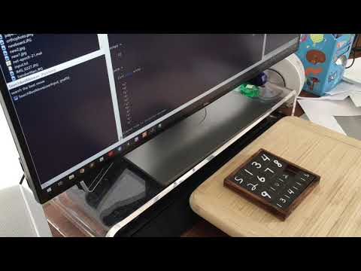
Demo video
Latest

Slide 21
4-Results

Slide 22
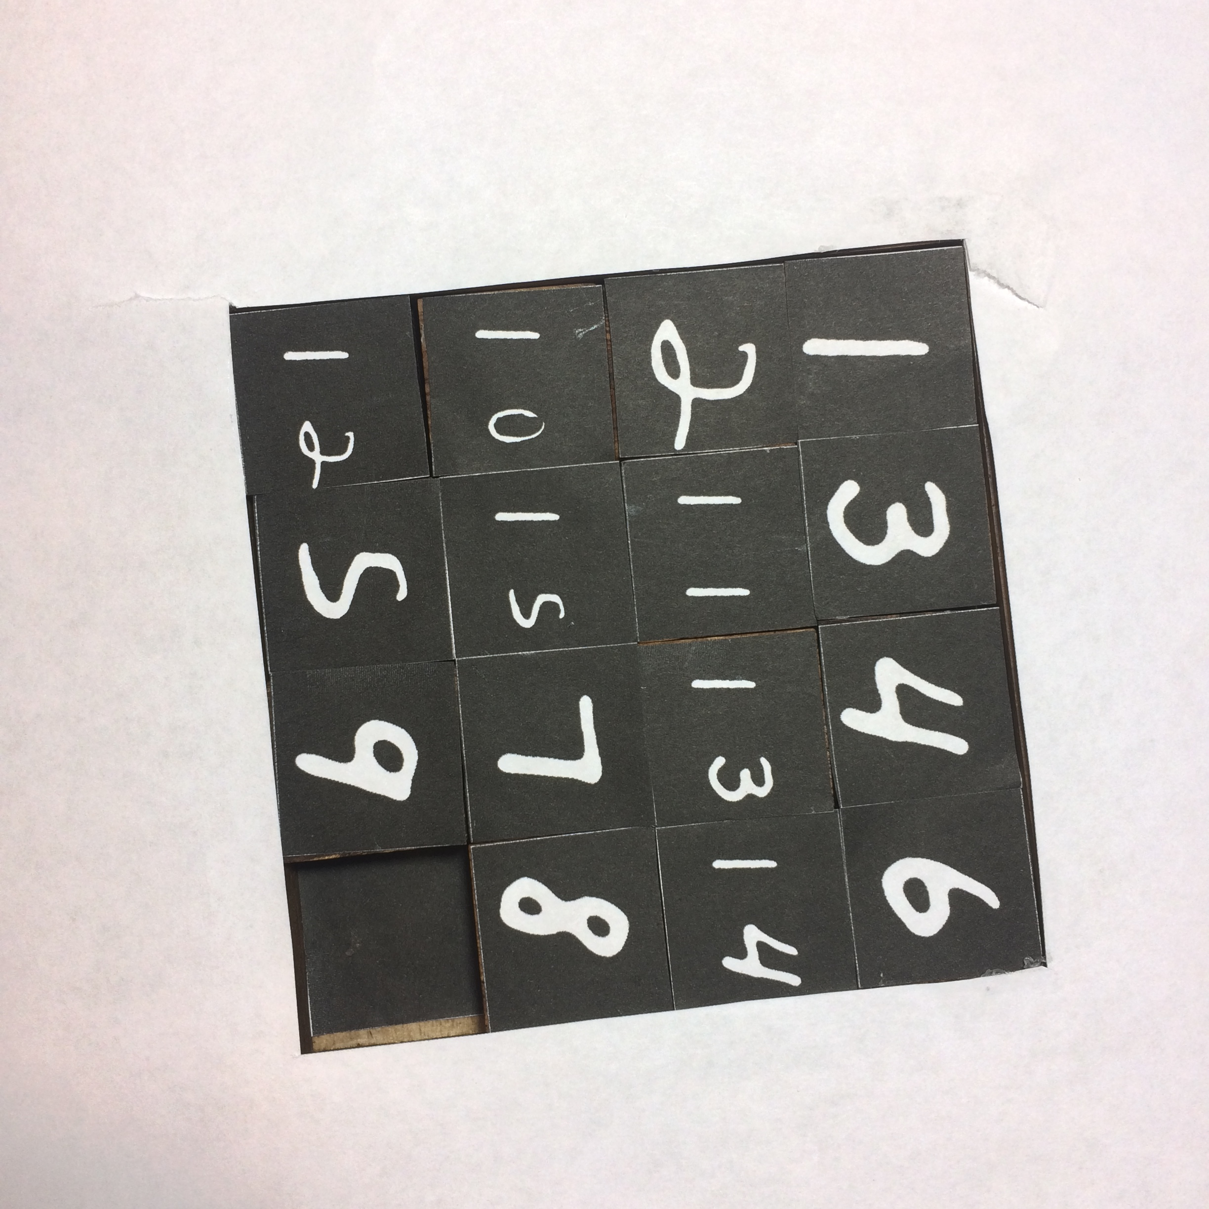
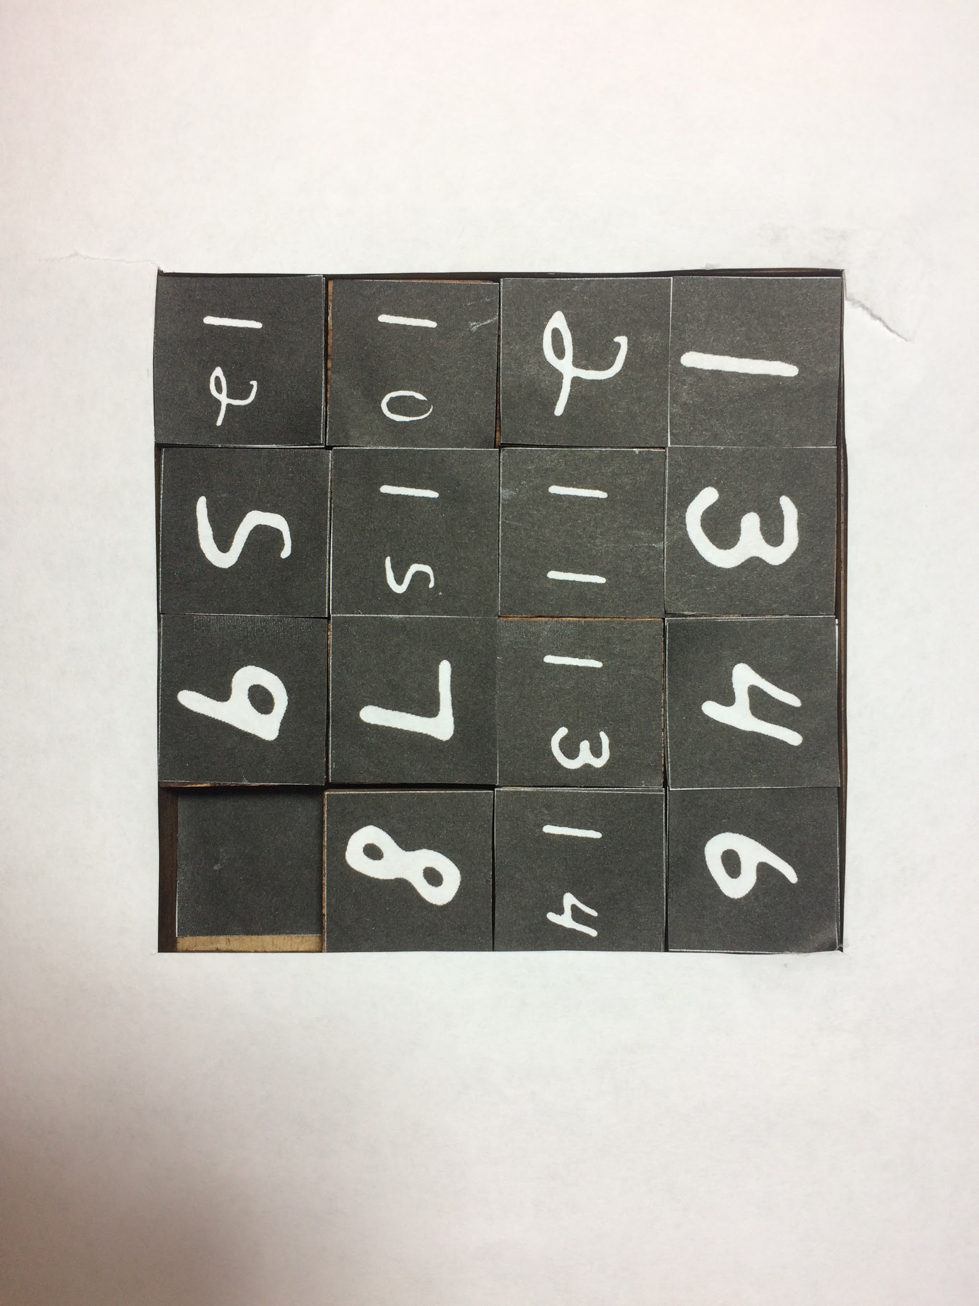
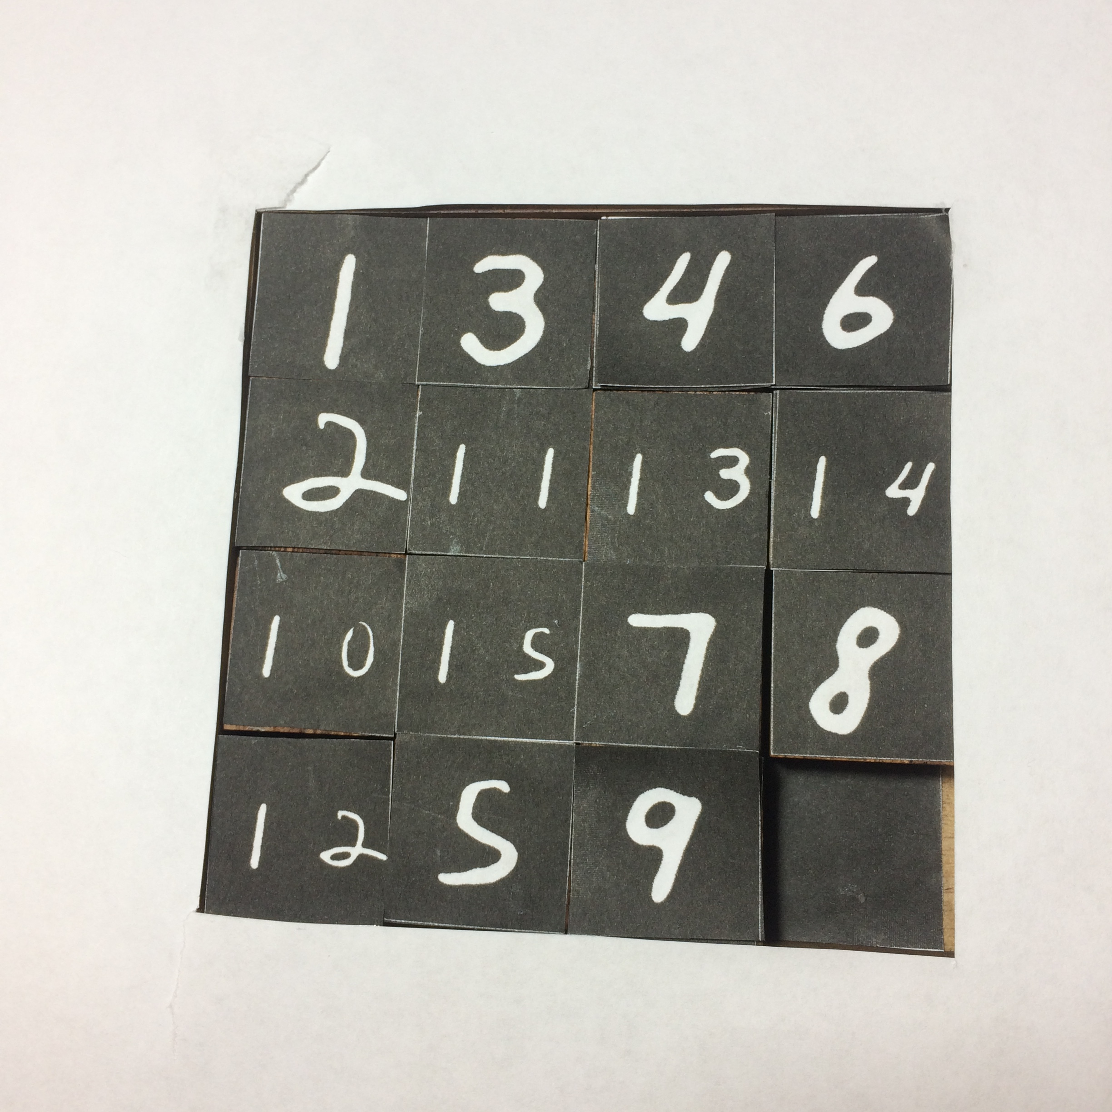
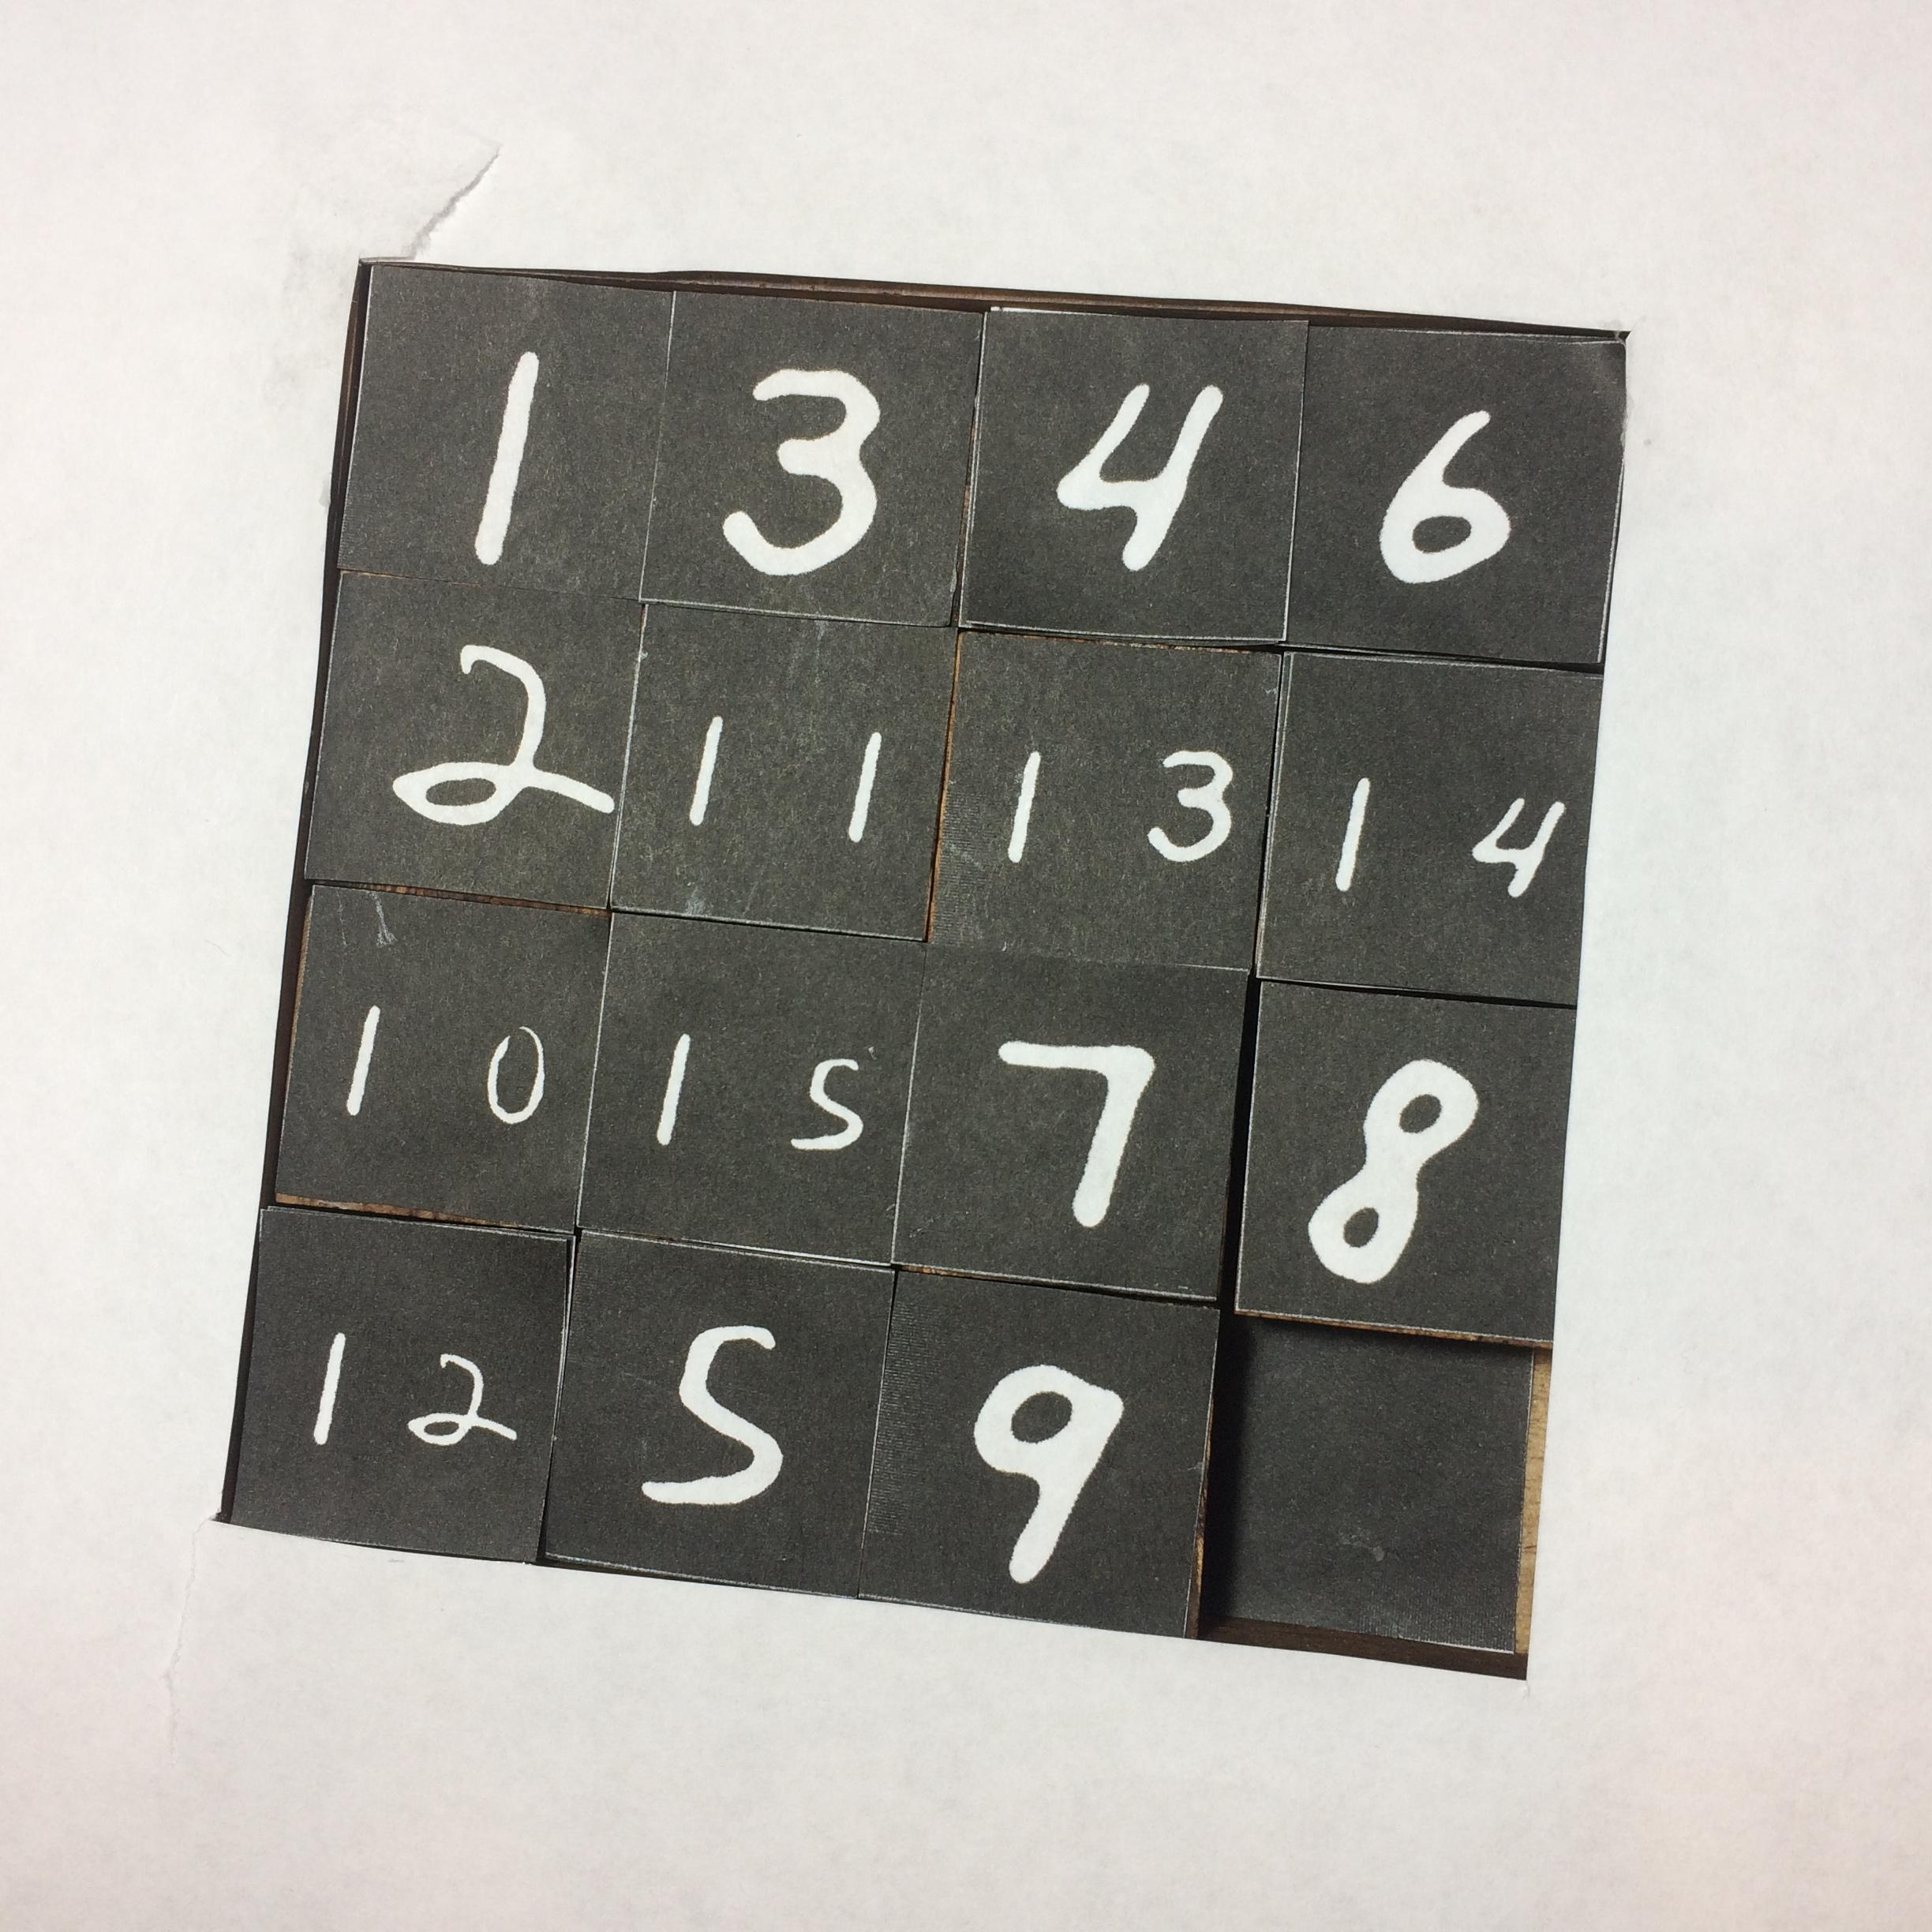
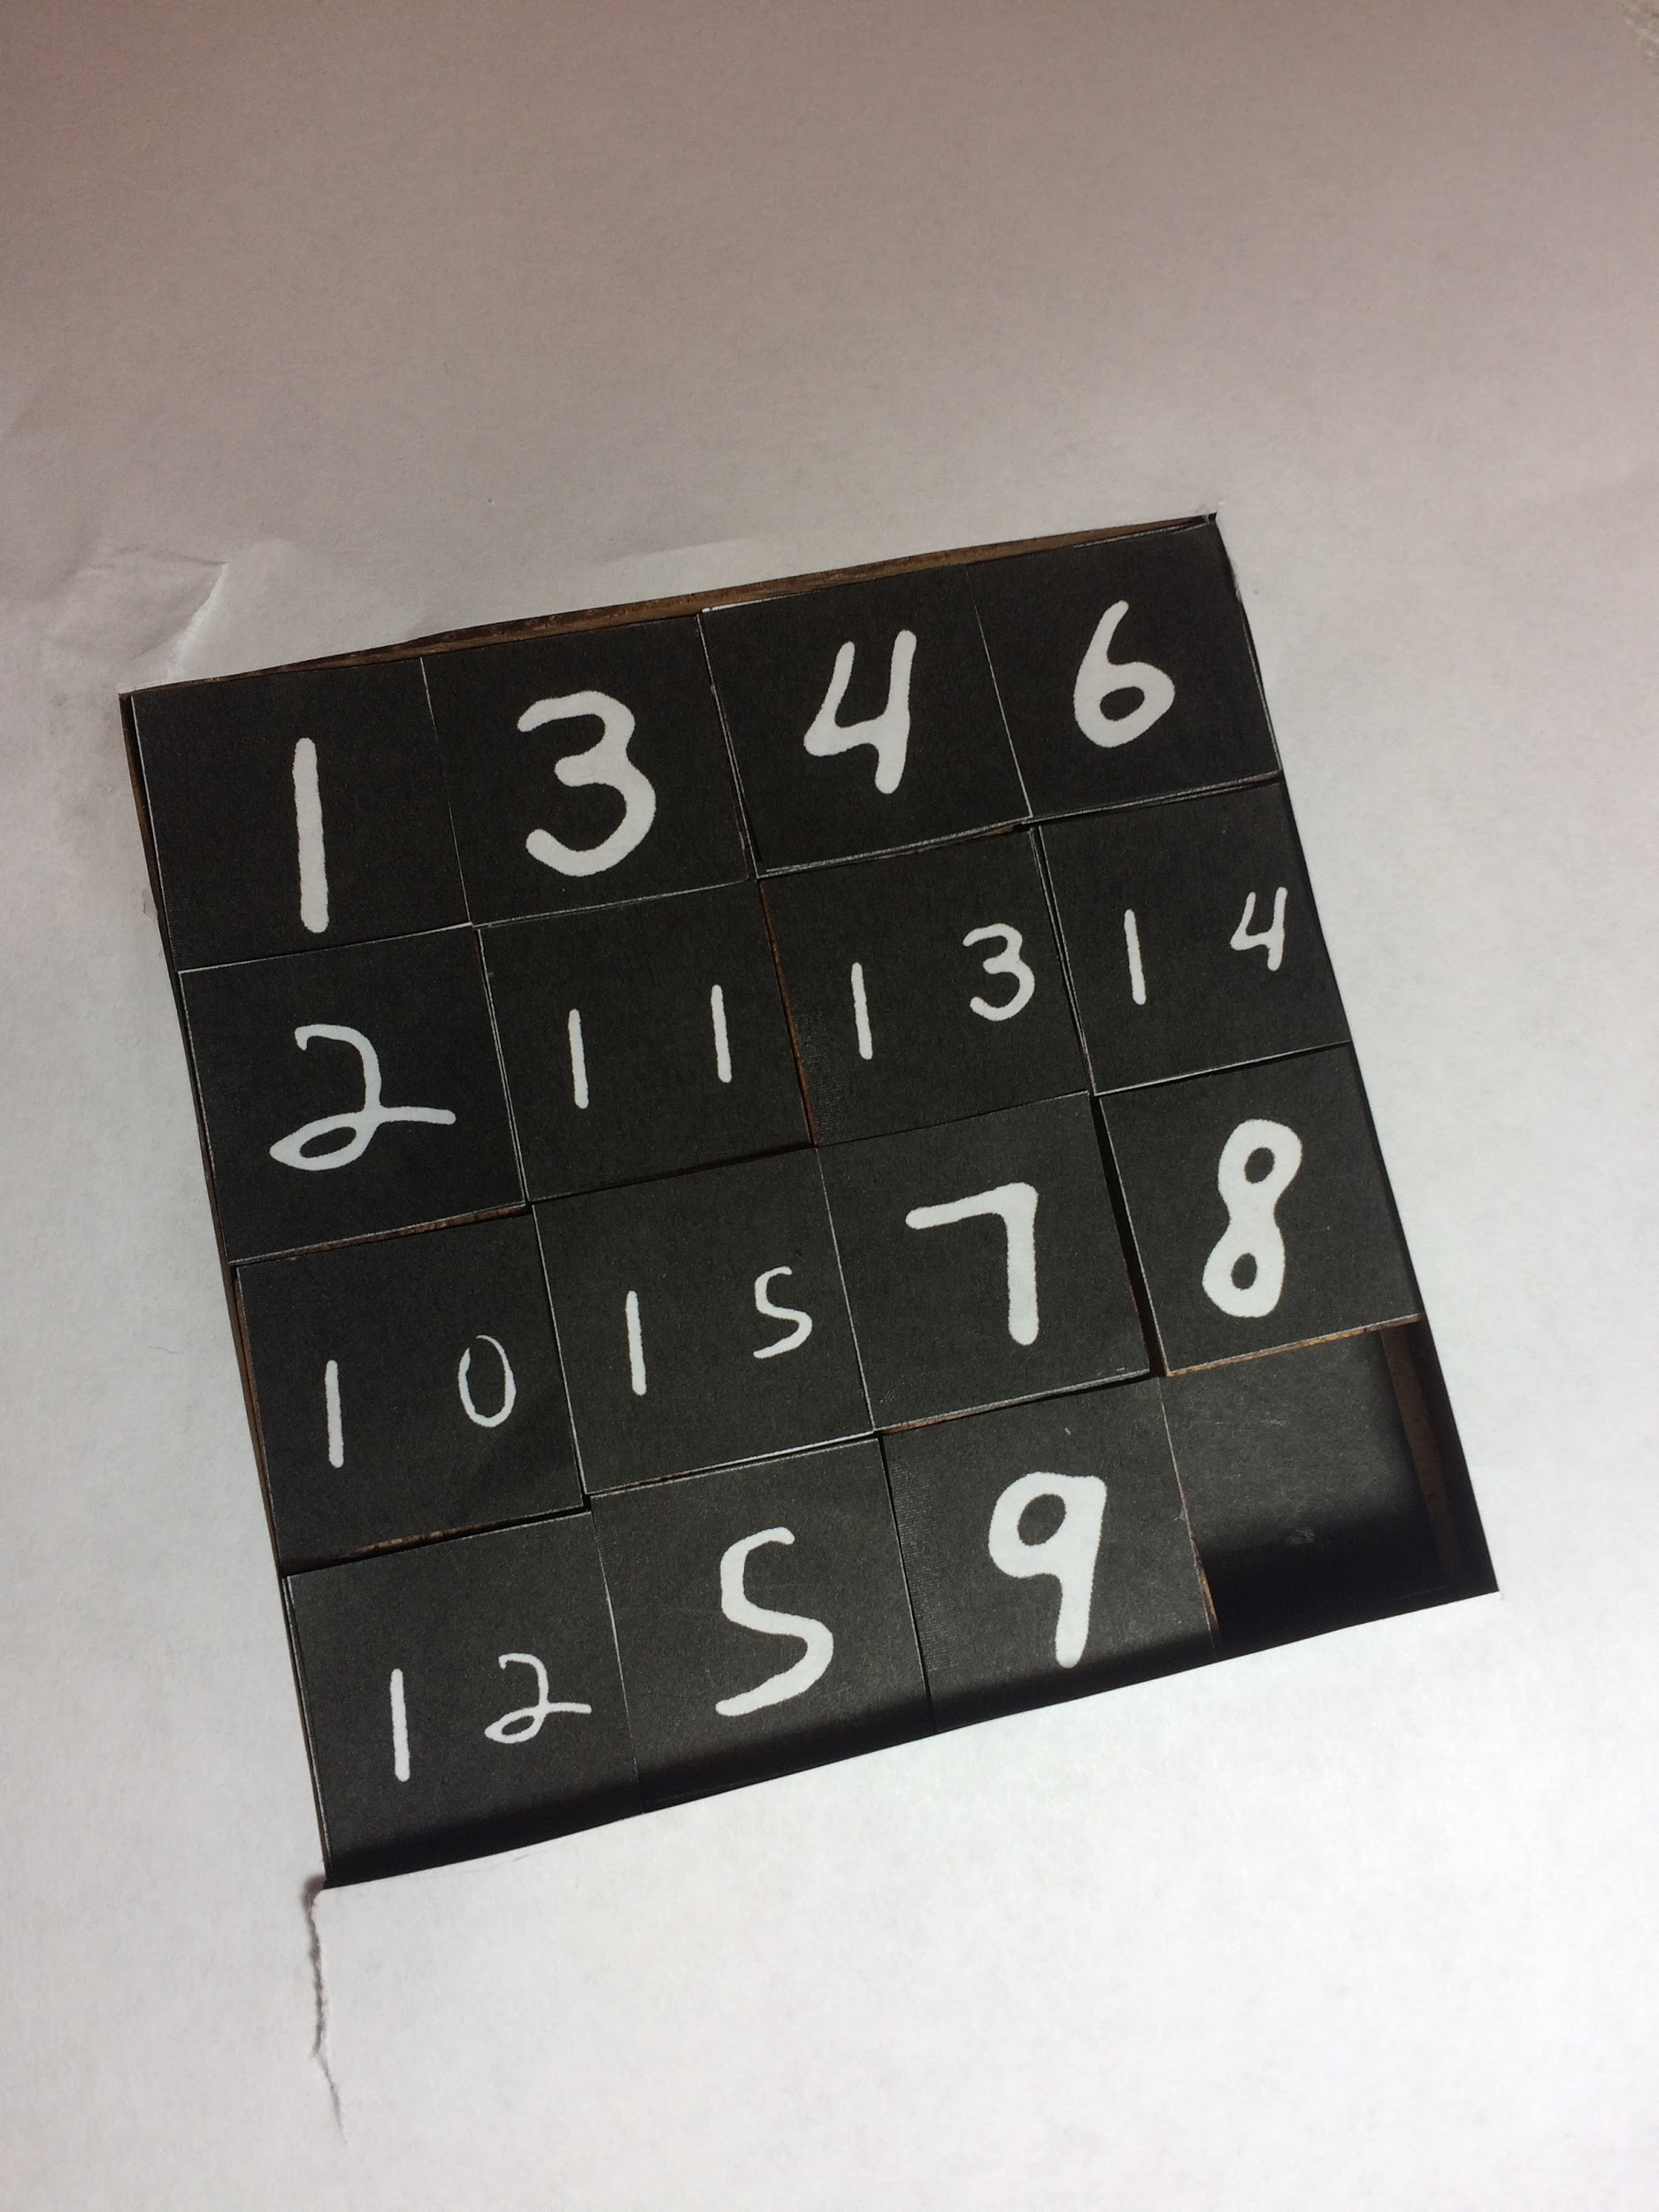
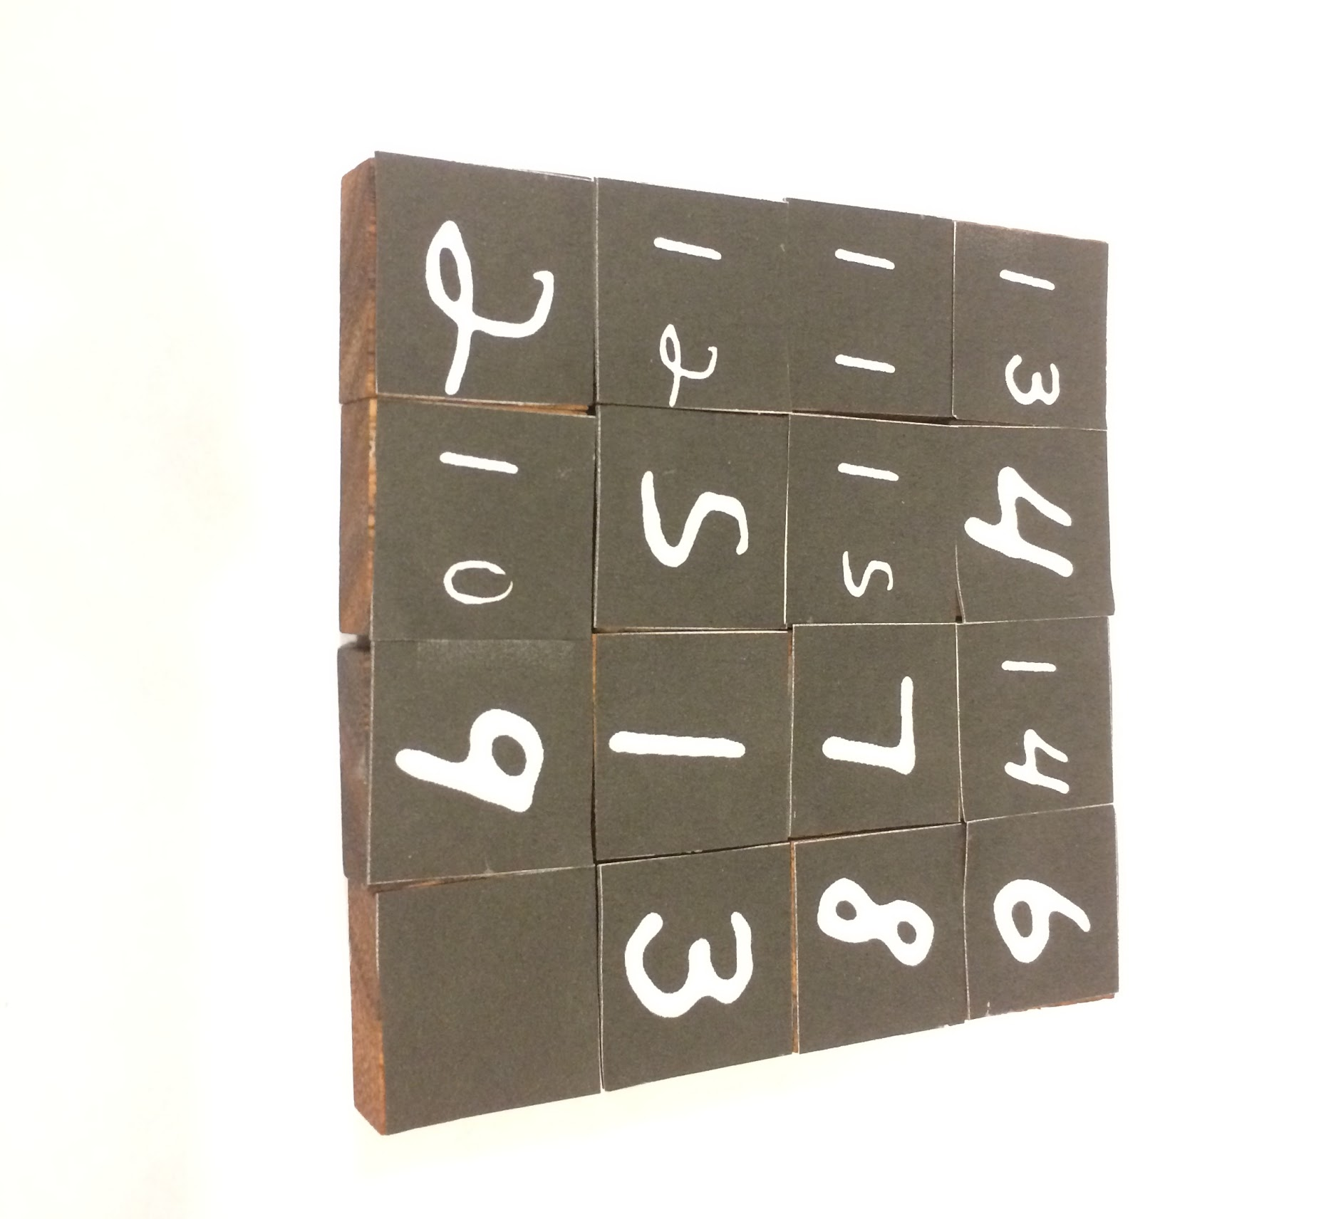
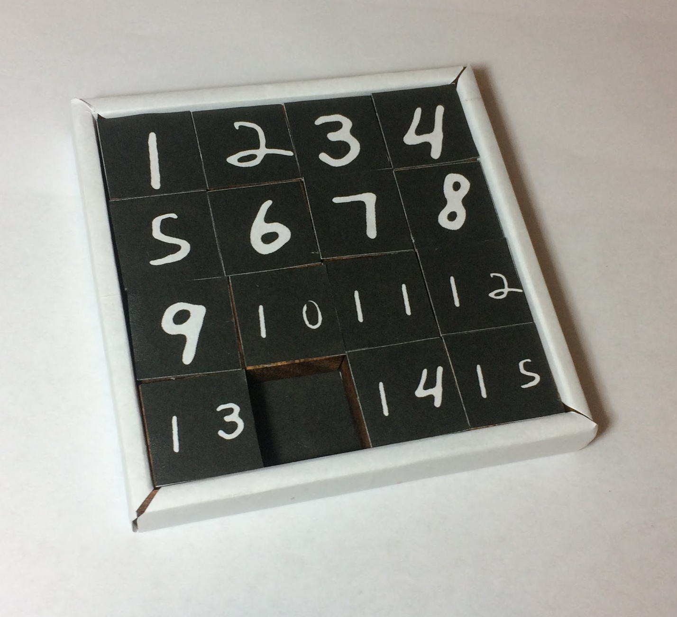
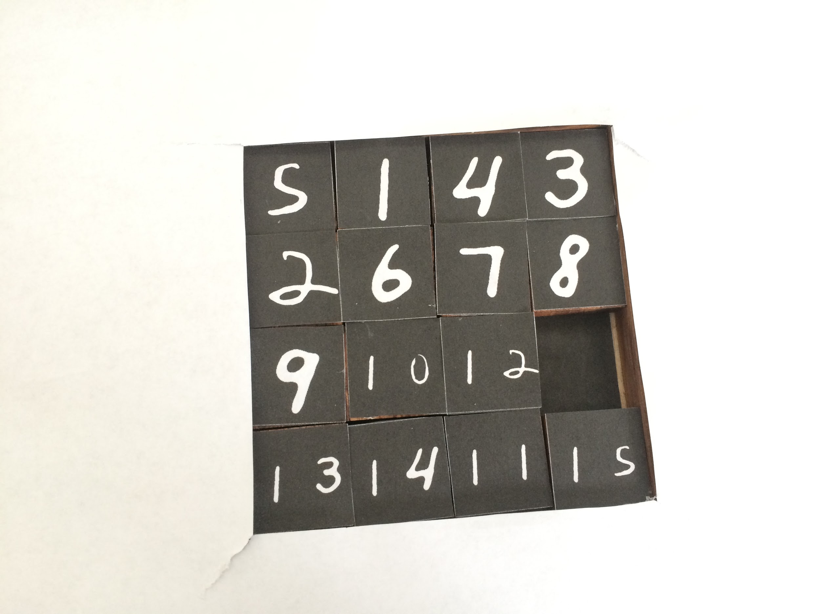
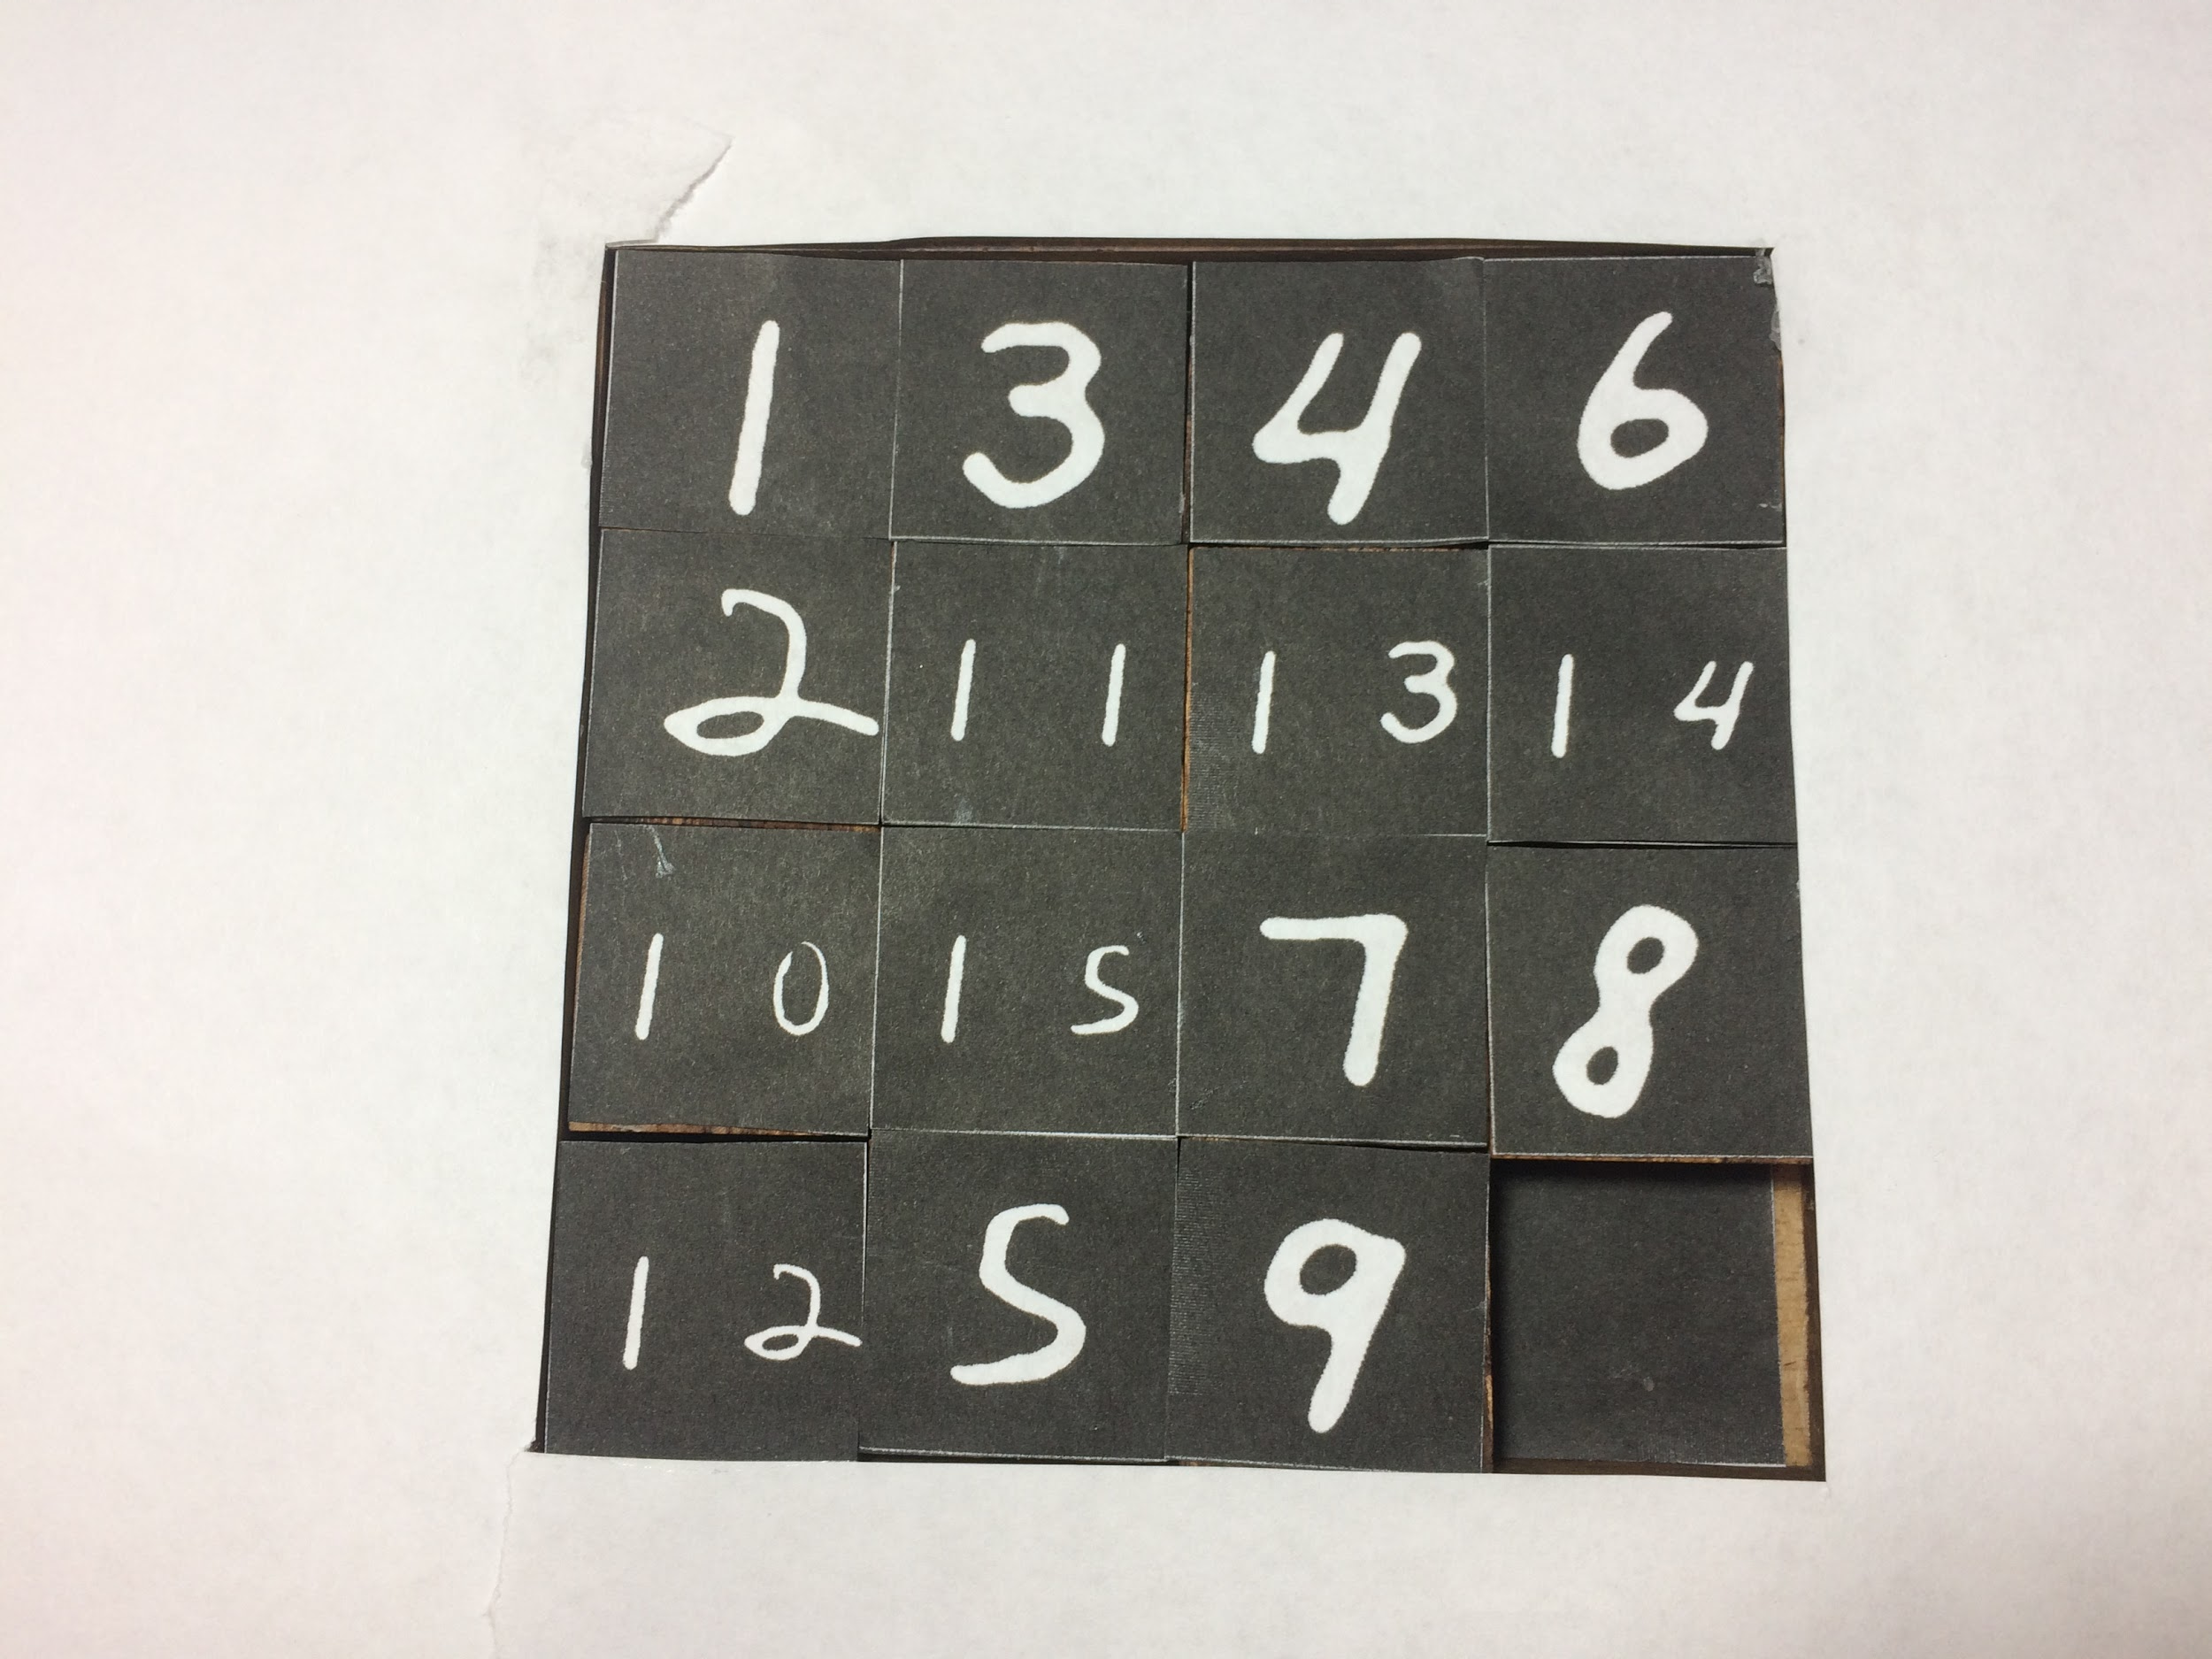
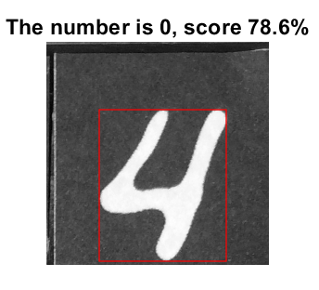
Number Recognition
Neural network performance on multiple photos
We tested 10 photos
1 detection error out of 160 tiles: 4 registered as 0 in the lower right image
We will try to test out more photos before the final report
Latest
Notes:
4: Too close to the edge

Slide 23
5-Conclusion

Slide 24
Discussion & Future Works
Achievement We taught the virtual agent to play 15 puzzles!
Limitation
Very specific lighting condition and intentionally-designed high-contrast game board.
Not achieving real time performance originally intended - Matlab is notoriously slow, the whole pipeline takes about 20s to generate a solution from game board picture (80s if implementing auto-right-side-up)
Small chance of detection error - the virtual agent might read the puzzle wrong

Slide 25
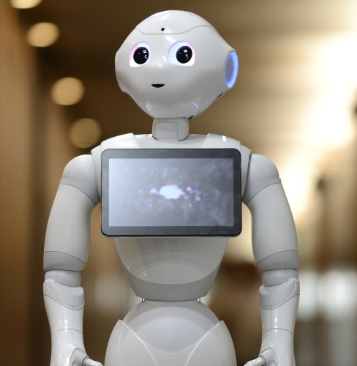
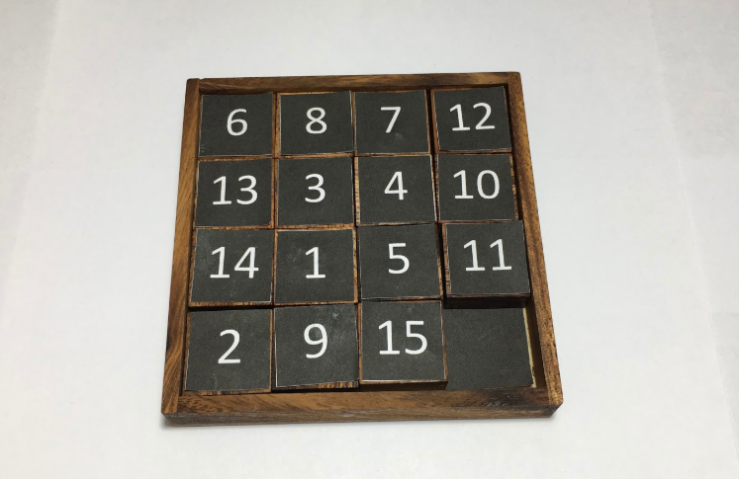
Future Work
Implement the code using OpenCV to achieve real time performance
Deploy the neural network and algorithm pipeline to edge computing
TensorRT framework on an Nvidia Xavier Board
Humanoid robot wirelessly connected with workstation
https://wtvox.com/robotics/pepper-the-robot-that-reads-emotions-goes-on-sale/

Slide 26
Thanks! Any question?

